Slide 1
Parametric Models

Slide 2

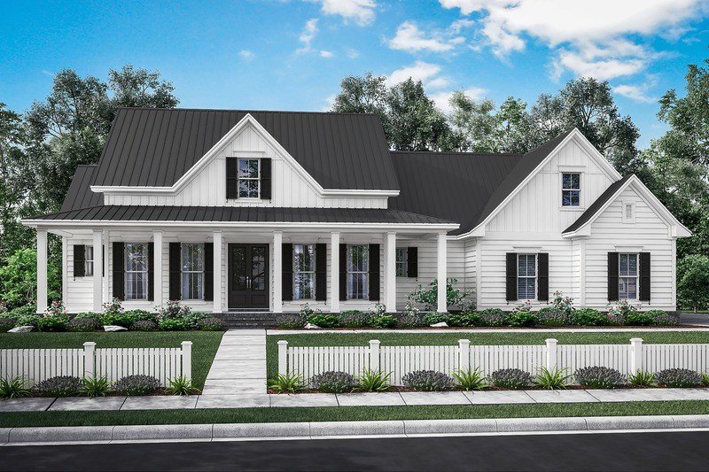
Housing Market
Notes:
https://cdn.houseplans.com/product/q5qkhirat4bcjrr4rpg9fk3q94/w800x533.jpg?v=8
https://images.dwell.com/photos/6328431439726800896/6445880622670512128/large.jpg

Slide 3
Housing Market – Decision Tree
Bedrooms < 2
$100k
Bedrooms < 4
Bathrooms < 2
Bedrooms < 6
$200k
$300k
…

Slide 4
Housing Market – Decision Tree
Bedrooms < 2
Bedrooms < 2
$100k
$140k
Bedrooms < 4
Bedrooms < 4
Bathrooms < 2
Bedrooms < 6
Market = Coastal
Bedrooms < 6
$200k
$300k
…
$500k
$250k
…

Slide 5
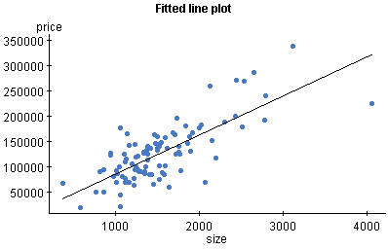
Linear Regression – The Basics

Slide 6
Linear Regression – The Basics
Y ≈ β₀ + β₁X.
y = w₀ + w₁*x

Slide 7
Linear Regression – The Basics
Y ≈ β₀ + β₁X.
y = w₀ + w₁*x
How do I find (or generate) this line of best fit?

Slide 8
Logistic Regression – Multiple Dimensions
X = [x₁], we care about w₀ (bias, intercept) + w₁(weight, slope) * x₁
What about multiple dimensions?

Slide 9
Logistic Regression – Multiple Dimensions
X = [x₁], we care about w₀ (bias, intercept) + w₁(weight, slope) * x₁
What about multiple dimensions? Each Dimension Gets a Weight!
X = [x₁, x₂, x₃,…, x_{n}]
w₀ + w₁ * x₁ + w₂ * x₂ + w₃ * x₃ + … + w_{n} * x_{n} = W ∙ X
(NOTE: For dot product to work, X needs to be prepended, X = [1,x₁, …]

Slide 10
Linear Regression – The Details
First, let’s define “how good” a line is.
- How well does it define our points?

Slide 11
Linear Regression – The Details
First, let’s define “how good” a line is.
- How well does it define our points?
How far away, on average, is each point from the line?
The Mean Squared Error
The difference between each point and the line along the output axis
(square this value to get it to always be a positive value)
Take the mean of this value

Slide 12
Linear Regression – The Details
First, let’s define “how good” a line is.
- How well does it define our points?
How far away, on average, is each point from the line?
The Mean Squared Error
We want the minimum distance from the points to the line.

Slide 13
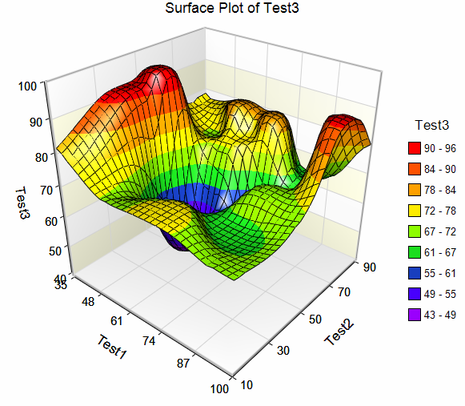
Minimizing a function…
Assume Test1 and Test2 are our w values, we want to minimize Test3. How would you do it?
Notes:
https://sg.fiverrcdn.com/photos/99524726/original/bb6eda30c9f6992ac0681a9c8ea5f25c656aa4c8.png?1500226043

Slide 14
Optimize by checking all points, choosing min

Slide 15
Optimizing using the gradient
For any function f, there exists a gradient.
The gradient is the vector that points in the direction in which f is increasing the fastest.

Slide 16
Optimize using the gradient

Slide 17
Optimizing argmin(MSE(w))
Gradient descent would not work for any given function…
Notes:
https://sg.fiverrcdn.com/photos/99524726/original/bb6eda30c9f6992ac0681a9c8ea5f25c656aa4c8.png?1500226043

Slide 18
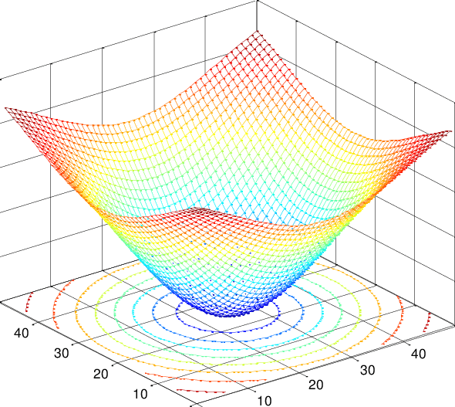
Optimizing argmin(MSE(w))
But our function is a linear function, which happens to be concave!
i.e. If we’re at a local minimum, we’re at the global minimum
https://homes.cs.washington.edu/~marcotcr/blog/concavity/
Notes:
https://www.researchgate.net/profile/Maria_Barbarosou/publication/230787652/figure/fig2/AS:669131099623428@1536544694590/The-2D-Caussian-function-of-Example-2-Example-1-Consider-the-following-strongly-convex.png

Slide 19
Optimizing using Gradient Descent
We can think of this in terms of updating our weights:
w ← w – ∇_{w} MSE(w)
∇_{w} MSE(w) = [∂MSE(w) / ∂w₀, ∂MSE(w) / ∂w₁, … , ∂MSE(w) / ∂w_{n}]
The weights are updated by removing the gradient
Each weight is updated by subtracting its partial derivative

Slide 20
Optimizing using Gradient Descent
We can think of this in terms of a rate of change:
w ← w – λ * ∇_{w} MSE(w)

Slide 21
Optimizing using Gradient Descent
We can think of this in terms of each feature weight’s update:
w_{k} ← w_{k} – λ * ∂MSE(w) / ∂w_{k} for each k = 0 → D (dimensions)

Slide 22
Optimizing using Gradient Descent
We can think of this in terms of each feature weight’s update:
w_{k} ← w_{k} – λ * ∂MSE(w) / ∂w_{k} for each k = 0 → D (dimensions)
We can think of the partial derivative* of w_{k} in terms of the k^{th} feature of the i^{th} training example
*The proof of this fact can be found in readings… (i.e. it’s really hard math!)

Slide 23
Exercise – Regression (B)
Linear Regression of our California Housing Dataset

Slide 24
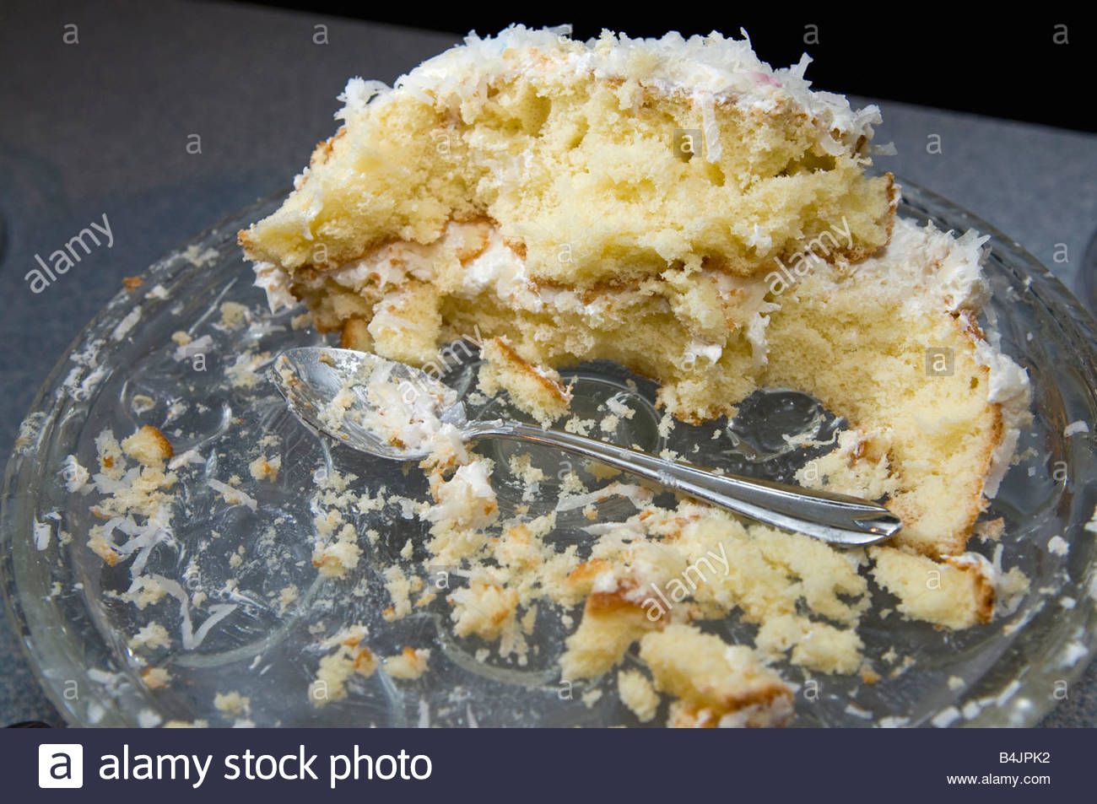
Classification – A New Problem Space
?
Notes:
https://c8.alamy.com/comp/B4JPK2/half-eaten-birthday-cake-you-cant-have-your-cake-and-eat-it-B4JPK2.jpg

Slide 25
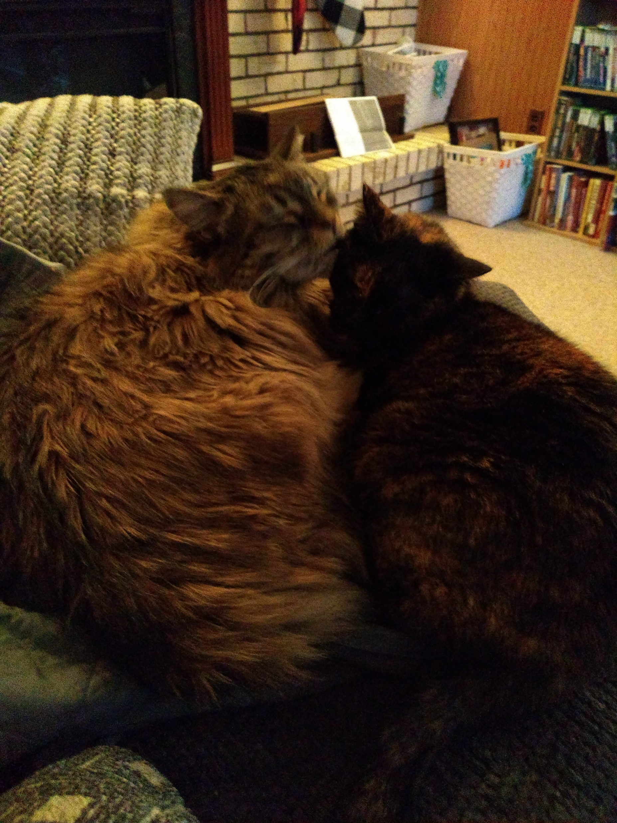
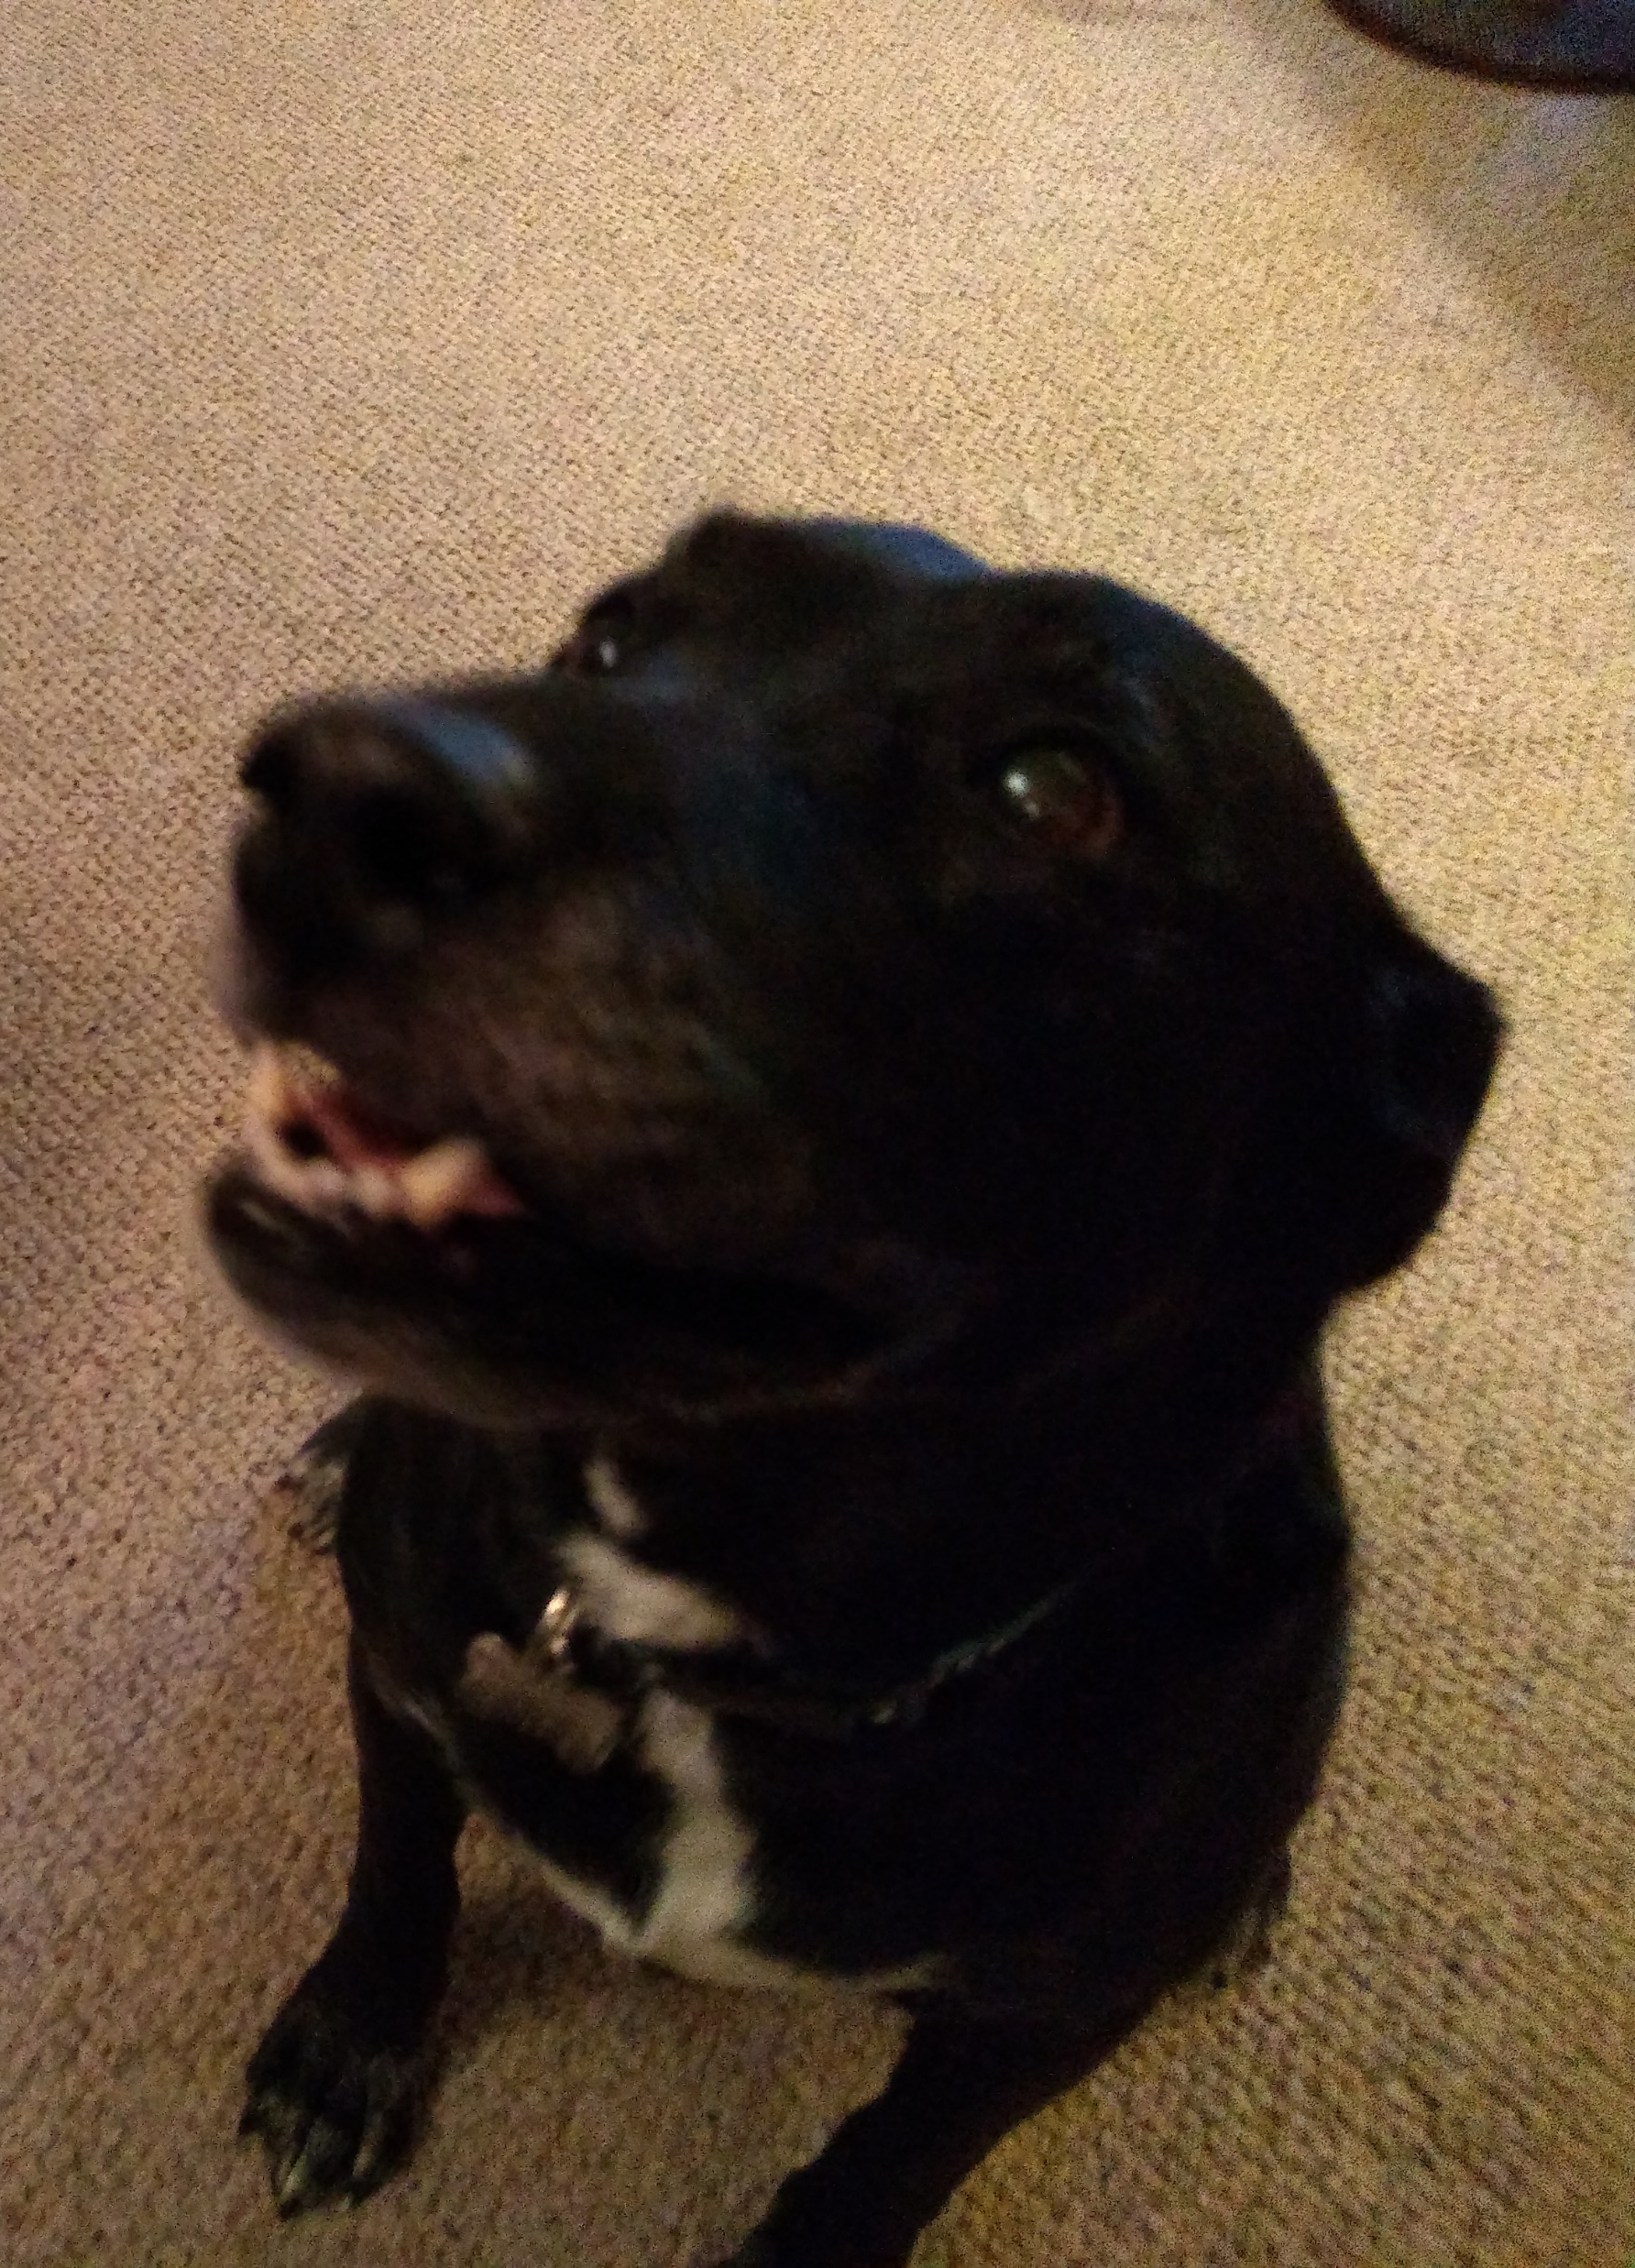
Classification – A New Problem Space
?
Notes:
https://c8.alamy.com/comp/B4JPK2/half-eaten-birthday-cake-you-cant-have-your-cake-and-eat-it-B4JPK2.jpg
https://smithfarmslabradors.com/images/females/black-lab_chalet-full.jpg
https://www.dogbreedinfo.com/images4/DroolSpikeYuck.JPG

Slide 26
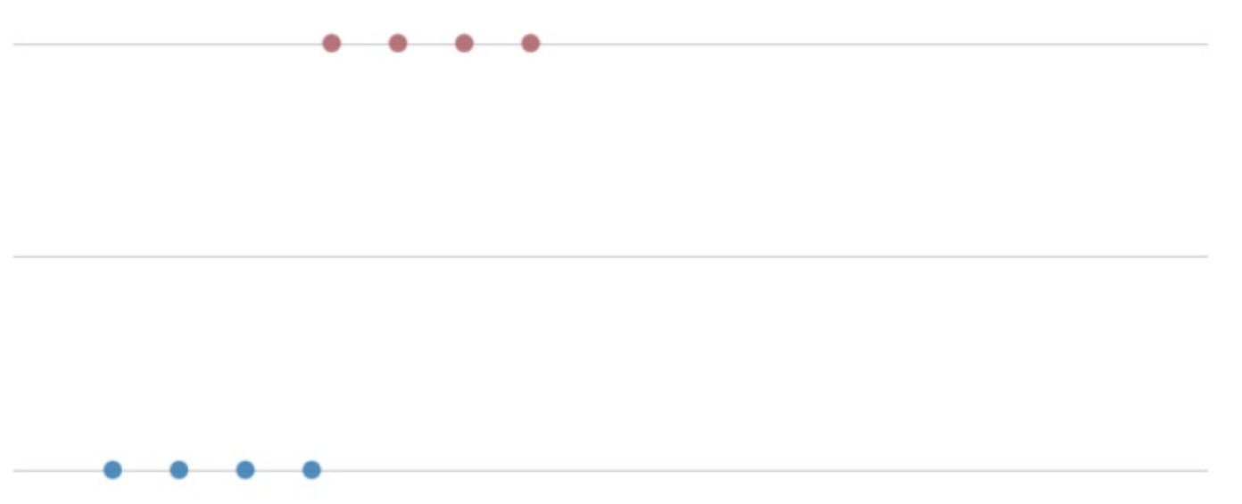
Our Problem Space – Dog Slobber
1 – Dog
0 - ~Dog
Slobber (ml)

Slide 27
Binary → Categorical → Regression Classification Classification
Positive vs Negative Red “Can we guess
Orange your age based on
Yellow the year you
OR Green graduated high
Blue school?”
Indigo OR
Cancer vs. Violet House Price
~Cancer Prediction

Slide 28
Regression → Classification
“Can we guess your age?” → “Are you a 90’s kid?”

Slide 29
Classification → Binary Classification
Is this tweet positive Is this tweet positive or not positive?
or negative?
Y = {pos, neg} Y = {1, 0}
y = argmax_{c} p(c|x, D) p(y=0 | x, D) = 1 – p(y=1 | x, D)

Slide 30
Our Problem Space – Dog Slobber
1 – Dog
0 - ~Dog
Slobber (ml)
Modeling p(y | x, D) given one feature (slobber)?

Slide 31
Our Problem Space – Dog Slobber
1 – Dog
0 - ~Dog
Slobber (ml)
Linear Regression
p(y | x, D) = β₀ + β₁X.

Slide 32
Our Problem Space – Dog Slobber
1 – Dog
0 - ~Dog
Slobber (ml)
Linear Regression
p(y | x, D) = β₀ + β₁X.

Slide 33
Our Problem Space – Dog Slobber
1 – Dog
0 - ~Dog
Slobber (ml)
Perceptron if x > 50 ml, y = 1
else, y = 0

Slide 34
Our Problem Space – Dog Slobber
1 – Dog
0 - ~Dog
Slobber (ml)
Logistic Function

Slide 35
Our Problem Space – Dog Slobber
1 – Dog
0 - ~Dog
Slobber (ml)
Logistic Function p(X) = e^{w0+w1*X}
1 + e^{w0+w1*X}

Slide 36
Logistic Function
Logistic Function p(X) = e^{w0+w1*X} = 1
1 + e^{w0+w1*X} 1 + e ^{–(w0+w1*X)}

Slide 37
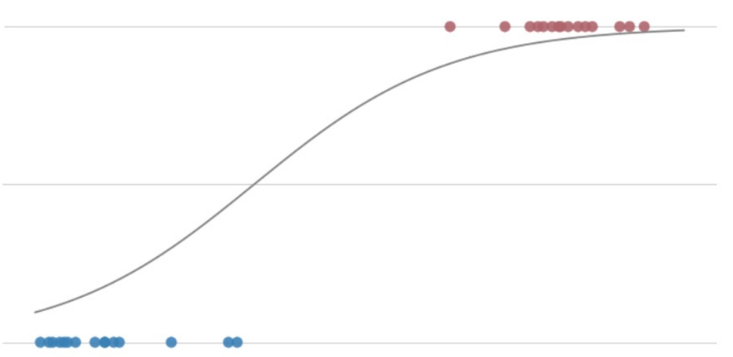
Our Problem Space – Dog Slobber
1 – dog
0 - ~dog
Slobber (ml)
if p(X) >= .5, y = 1
else, y = 0

Slide 38
Logistic Regression
- Simple discriminative model
- Easy to train
- Does not make data assumptions
- Works well on medium data sets
Logistic Function
- Probabilistic (values 0 – 1)
- Very Smooth

Slide 39

My NLP Problem
- Manager for Roc Nation
- Contract renewal for Rihanna
- What is public hype for her newest album?
Positive or ~Positive?
OUR APPROACH:
Mining Twitter Feedback
Notes:
https://rocnation.com/rihanna/
https://pbs.twimg.com/media/Dwp8QyEUcAEJC3n.jpg

Slide 40
Everything You Need to Know About Natural Language Processing in 5 Minutes*
*This is impossible. You’ll talk more about NLP tomorrow, but if you care about doing NLP in the real world, consider taking the NLP Class, CSCI 5832 (cross listed in LING), through Continuing Education.

Slide 41
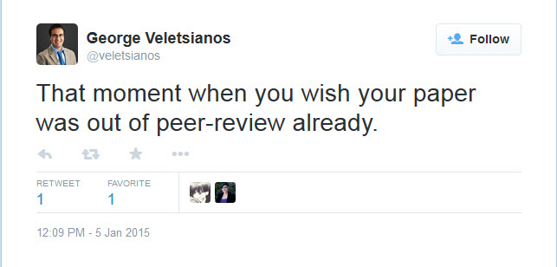
What’s in a Tweet?
Veletsianos, G. [veletsianos]. (2015, January 5). That moment when you wish your article was out of peer-review already [Tweet]. Retrieved from https://twitter.com/veletsianos/status/552195307555934208

Slide 42

Tweets as Documents
Each tweet is a sample
Draw features from each
RRU Library [RRULibrary]. (2015, February 15). Questions about academic writing or #APA style? Find the right answer in WriteAnswers http://ow.ly/J4fYL [Tweet]. Retrieved from https://twitter.com/RRULibrary/status/568462871081959425

Slide 43
Words as Features
Look for the presence or absence of any given word, and count that as that feature
I think Rihanna’s new album is going to be great!
Feature | X₁ = “Cool” | X₂ = “Great” | X₃ = “Bad” | X₄ = “Hate”
Is In Tweet | 0 | 1 | 0 | 0

Slide 44
Words as Features
Look for the presence or absence of any given word, and count that as that feature
I think Rihanna’s new album is going to be lit!
Feature | X₁ = “Cool” | X₂ = “Great” | X₃ = “Bad” | X₄ = “Hate”
Is In Tweet | 0 | 0 | 0 | 0

Slide 45
Choosing our Feature Words
How will we pick our words?

Slide 46
Choosing our Feature Words
How will we pick our words?
Trust the Experts!
Looking at datasets like AFINN, or SentiWordNet, can give us an idea of words we care about if we’re looking for sentiment.
https://github.com/fnielsen/afinn/tree/master/afinn/data
https://github.com/aesuli/sentiwordnet

Slide 47

Choosing our Feature Words
How will we pick our words?
Use all the words in your dictionary?
Use all the words in your dataset?
https://imgflip.com/i/3nld61

Slide 48
Logistic Regression – Multiple Dimensions
X = [x₁], we care about w₀ (bias, intercept) + w₁(weight, slope) * x₁
What about multiple dimensions? Each Dimension Gets a Weight!
X = [x₁, x₂, x₃,…, x_{n}]
w₀ + w₁ * x₁ + w₂ * x₂ + w₃ * x₃ + … + w_{n} * x_{n} = W ∙ X
(NOTE: For dot product to work, X needs to be prepended, X = [1,x₁, …])
How do we choose a weight? Trust the experts? Good guesswork? At random? We’ll explore this later!

Slide 49
Logistic Regression – Rihanna Example
Feature | X₀ = Bias | X₁ = “Cool” | X₂ = “Great” | X₃ = “Bad” | X₄ = “Hate”
Weight | 0.1 | 1.0 | 3.0 | -2.0 | -3.0

Slide 50
Logistic Regression – Rihanna Example
What classification do we give x=[“Cool”, “Bad”]
x = [1, 1, 0, 1, 0]
w₀ + w₁ * x₁ + w₂ * x₂ + w₃ * x₃ + w₄ * x₄
0.1 + 1.0 * 1 + 3.0 * 0 + -2.0 * 1 + -3.0 * 0 = -0.9
Feature | X₀ = Bias | X₁ = “Cool” | X₂ = “Great” | X₃ = “Bad” | X₄ = “Hate”
Weight | 0.1 | 1.0 | 3.0 | -2.0 | -3.0

Slide 51
Logistic Regression – Rihanna Example
What classification do we give x=[“Cool”, “Bad”]
x = [1, 1, 0, 1, 0]
Score = -0.9
1 = 0.289 < 0.5 = Negative Tweet!
1 + e ^{–(-0.9)}
Feature | X₀ = Bias | X₁ = “Cool” | X₂ = “Great” | X₃ = “Bad” | X₄ = “Hate”
Weight | 0.1 | 1.0 | 3.0 | -2.0 | -3.0

Slide 52
Logistic Regression – Rihanna Example
What classification do we give x=[“Cool”, “Bad”]
x = [1, 1, 0, 1, 0]
Score = -0.9
1 = 0.289 < 0.5 = Negative Tweet!
1 + e ^{–(-0.9)}
Feature | X₀ = Bias | X₁ = “Cool” | X₂ = “Great” | X₃ = “Bad” | X₄ = “Hate”
Weight | 0.1 | 1.0 | 3.0 | -2.0 | -3.0

Slide 53
Logistic Regression – Working with Weights
What sort of relationship do we see from weights and classification?
Feature | X₀ = Bias | X₁ = “Cool” | X₂ = “Great” | X₃ = “Bad” | X₄ = “Hate”
Weight | 0.1 | 1.0 | 3.0 | -2.0 | -3.0

Slide 54
Logistic Regression – Weights Fall short
Take the tweet “Rihanna’s new album was great! Haters say it was bad, but it was great, great, great!”
X = [“great”, “hate”, “bad”, “great”, “great”, “great”]
The way we’ve been doing them, that’s x = [1,0,1,1,1]
Is that going to come out positive or negative?
Feature | Bias | X₁ = “Cool” | X₂ = “Great” | X₃ = “Bad” | X₄ = “Hate”
Weight | 0.1 | 1.0 | 3.0 | -2.0 | -3.0

Slide 55
Logistic Regression – Weights Fall short
Take the tweet “Rihanna’s new album was great! Haters say it was bad, but it was great, great, great!”
X = [“great”, “hate”, “bad”, “great”, “great”, “great”]
The way we’ve been doing them, that’s x = [1,0,1,1,1]
Is that going to come out positive or negative?
Can you think of another way to use our accounting of features?
Feature | Bias | X₁ = “Cool” | X₂ = “Great” | X₃ = “Bad” | X₄ = “Hate”
Weight | 0.1 | 1.0 | 3.0 | -2.0 | -3.0

Slide 56
Logistic Regression – Binary vs. Bag of Words
Take the tweet “Rihanna’s new album was great! Haters say it was bad, but it was great, great, great!”
X = [“great”, “hate”, “bad”, “great”, “great”, “great”]
The way we’ve been doing them, that’s x = [1,0,1,1,1]
What if we count the number of instances of each word x = [1,0,4,1,1]
Feature | Bias | X₁ = “Cool” | X₂ = “Great” | X₃ = “Bad” | X₄ = “Hate”
Weight | 0.1 | 1.0 | 3.0 | -2.0 | -3.0

Slide 57
Logistic Regression – Binary vs. Bag of Words
Take the tweet “Rihanna’s got a new album”
X = [1, 0, 0, 0, 0]
Feature | X₀ = Bias | X₁ = “Cool” | X₂ = “Great” | X₃ = “Bad” | X₄ = “Hate”
Weight | 0.1 | 1.0 | 3.0 | -2.0 | -3.0

Slide 58
Logistic Regression – What are the Odds?
Probability vs. Odds
p(y) p(y) / (1 - p(y)) = p(y) / p(~y)
p(y) = .1 .1 / .9 = 1/9
p(y) = .75 .75 / .25 = 3
(if the odds are less than 1, we often flip it and think in terms of “against” the positive)
p(y) = .1 .1 / .9 = 9 to 1 against
p(y) = .75 .75 / .25 = 3 to 1 for

Slide 59
Logistic Regression - Odds
p(x) = 1
1 + e ^{–(score)}
1
1 + e ^{–(score)}
Odds = ______________________________
1 - 1
1 + e ^{–(score)}
Odds = e^{score}

Slide 60
Logistic Regression – log-odds or logit
Odds = e^{score}
ln(odds) = score

Slide 61
Logistic Regression – Impact
Take the tweet “Rihanna’s new album was great! Haters say it was bad, but it was great, great, great!”
What is the impact of adding another “great”?
Feature | Bias | X₁ = “Cool” | X₂ = “Great” | X₃ = “Bad” | X₄ = “Hate”
Weight | 0.1 | 1.0 | 3.0 | -2.0 | -3.0

Slide 62
Logistic Regression – Binary vs. Bag of Words
Take the tweet “Rihanna’s new album was great! Haters say it was bad, but it was great, great, great!”
What is the impact of adding another “great”?
Odds = e0.1 + 1.0 * 0 + 3.0 * 4 + -2.0 * 1 + -3.0 * 1
vs.
Odds = e0.1 + 1.0 * 0 + 3.0 * (4 + 1) + -2.0 * 1 + -3.0 * 1
Odds = e^{3.0} *e0.1 + 1.0 * 0 + 3.0 * 4 + -2.0 * 1 + -3.0 * 1
Odds improved by a factor of (approximately) 20!
Feature | Bias | X₁ = “Cool” | X₂ = “Great” | X₃ = “Bad” | X₄ = “Hate”
Weight | 0.1 | 1.0 | 3.0 | -2.0 | -3.0

Slide 63
Logistic Regression – Weights for Features
I have this table of weights for my Features – where do they come from?
Feature | X₀ = Bias | X₁ = “Cool” | X₂ = “Great” | X₃ = “Bad” | X₄ = “Hate”
Weight | 0.1 | 1.0 | 3.0 | -2.0 | -3.0

Slide 64
Finding Weights
Best Guess
- Estimated from some background information or expertise
Equal Numbers
- If we don’t have any good ideas, just weight everything evenly
- This approach isn’t exactly the best, we’ll explore why later.
“Best” Guess
- What if we don’t have any information? Take any ol’ guess!
- Random numbers!*
*Random small numbers

Slide 65
Logistic Regression – Weights for Features
Once I have initialized my weights, I have to…
a) see how good they are
b) see if I can improve them
Feature | X₀ = Bias | X₁ = “Cool” | X₂ = “Great” | X₃ = “Bad” | X₄ = “Hate”
Weight | 0.1 | 0.621 | -.21 | -.19 | -.649

Slide 66
Checking Weights – Logistic Regression
Likelihood
p(y=1|x; w) = 1 / 1 + e ^{–(w ∙ x)}
p(y=0|x; w) = 1 – (1 / 1 + e ^{–(w ∙ x)})

Slide 67
Checking Weights – Logistic Regression
Likelihood
p(y=1|x; w) = 1 / 1 + e ^{–(w ∙ x)}
p(y=0|x; w) = 1 – (1 / 1 + e ^{–(w ∙ x)})
$p(y|x; w) = (1 / (1 + e ^{–(w ∙ x)}))^{y} * (1 – (1 / (1 + e ^{–(w ∙ x)})))^{1-y $}
$Bernoulli Random Variable$

Slide 68
Likelihood of Weights
Given {x_{i}, y_{i}}_{i=1➔n}, chosen weights w
L(w) = p({y_{i}} _{i=1➔n} |{x_{i}} _{i=1➔n}; w)
= ∏ _{i=1➔n}( p(y_{i}|x_{i}, w) )
= ∏ _{i=1➔n}( (1 / 1 + e ^{–(w ∙ xi)})^{yi} * (1 – (1 / 1 + e ^{–(w ∙ xi)}))^{1-yi}

Slide 69
Logistic Regression – Weights for Features
Once I have initialized my weights, I have to…
a) see how good they are
So I’ve discovered that these weights are only so-so…
b) see if I can improve them
Feature | X₀ = Bias | X₁ = “Cool” | X₂ = “Great” | X₃ = “Bad” | X₄ = “Hate”
Weight | 0.1 | 0.621 | -.21 | -.19 | -.649

Slide 70
Likelihood of Weights
Given {x_{i}, y_{i}}_{i=1➔n}, chosen weights w
L(w) = p({y_{i}} _{i=1➔n} |{x_{i}} _{i=1➔n}; w)
= ∏ _{i=1➔n}[p(y_{i}|x_{i}, w)]
= ∏ _{i=1➔n}[(1 / 1 + e ^{–(w ∙ xi)})^{yi} * (1 – (1 / 1 + e ^{–(w ∙ xi)})^{1-yi}]
We want to maximize L(w)
- We want the weights that are most likely to generate our y (answers) given our x (training examples)

Slide 71
Log-Likelihood of Weights
LL(w) = log(L(w))
= log[∏ _{i=1➔n}[(1 / 1 + e ^{–(w ∙ xi)})^{yi} * (1 – (1 / 1 + e ^{–(w ∙ xi)})^{1-yi}]]
= ∑ _{i=1➔n}[log[(1 / 1 + e ^{–(w ∙ xi)})^{yi}] + log[(1 – (1 / 1 + e ^{–(w ∙ xi)})^{1-yi}]]
Taking the log of a product…

Slide 72
Log-Likelihood of Weights
LL(w) = log(L(w))
= log[∏ _{i=1➔n}[(1 / 1 + e ^{–(w ∙ xi)})^{yi} * (1 – (1 / 1 + e ^{–(w ∙ xi)})^{1-yi}]]
= ∑ _{i=1➔n}[log[(1 / 1 + e ^{–(w ∙ xi)})^{yi}] + log[(1 – (1 / 1 + e ^{–(w ∙ xi)})^{1-yi}]]
= ∑ _{i=1➔n}[y_{i} * log[(1/1+e ^{–(w ∙ xi)})] + (1 - y_{i}) * log[(1 – (1/1+e ^{–(w ∙ xi)})]]
Pulling out the exponent (y_{i} and 1 – y_{i})…

Slide 73
Negative Log-Likelihood of Weights
NLL(w)= - log(L(w))
= - log[∏ _{i=1➔n}[(1 / 1 + e ^{–(w ∙ xi)})^{yi} * (1 – (1 / 1 + e ^{–(w ∙ xi)})^{1-yi}]]
= - ∑ _{i=1➔n}[log[(1 / 1 + e ^{–(w ∙ xi)})^{yi}] + log[(1 – (1 / 1 + e ^{–(w ∙ xi)})^{1-yi}]]
= - ∑ _{i=1➔n}[y_{i} * log[(1/1+e ^{–(w ∙ xi)})] + (1 - y_{i}) * log[(1 – (1/1+e ^{–(w ∙ xi)})]]
In math, optimization is typically done as a minimization problem*…
*thanks to log() being monotonically increasing / making our values negative, argmax(L(w)) = argmin(NLL(w))

Slide 74

Gradient Descent – Real World Examples
Real world example: predicting the weather
Notes:
https://thumbs.dreamstime.com/z/sun-clouds-rain-snow-storms-14353589.jpg

Slide 75
Gradient Descent – Predicting the weather
We have relevant features (temp, humidity, wind, latitude, longitude, time of day, day of year…)
- say 100 features, across 19,354 “incorporated places” in us
- current precipitation classification
We have sampled data points
- 1 sample per site per minute for 30 years
Notes:
https://thumbs.dreamstime.com/z/sun-clouds-rain-snow-storms-14353589.jpg

Slide 76
Gradient Descent – Predicting the weather
We have relevant features (temp, humidity, wind, latitude, longitude, time of day, day of year…
- say 99 features, across 19,354 “incorporated places” in us
- plus current precipitation classification
We have sampled data points
- 1 sample per site per minute for 30 years
3.05e+13 features
There are bigger problems out there!
Notes:
https://thumbs.dreamstime.com/z/sun-clouds-rain-snow-storms-14353589.jpg

Slide 77
Gradient Descent – Stochastic
w ← w – λ * ∇_{w} NLL(w)
But we can’t really fit everything into memory to calculate the true gradient…

Slide 78
Stochastic Gradient Descent
w ← w – λ * ∇_{w} NLL(w)
But we can’t really fit everything into memory to calculate the true gradient… So we estimate the gradient using one training example at a time.
w ← w – λ * ∇_{w} NLL(w | x_{i},y_{i})
w_{k} ← w_{k} – λ * [ (1/1+e ^{–(w ∙ xi)}) - y_{i}] * x_{ik} for k = 0 → D
Compared to w_{k} ← w_{k} – λ * ∑ _{i=1➔n}[ (1/1+e ^{–(w ∙ xi)}) - y_{i}] * x_{ik}

Slide 79
Stochastic Gradient Descent
So now we’re going through, updating our weights piecemeal, always getting closer to convergence…
Every loop through the training set is an epoch

Slide 80
Improvement: Mini-Batch Stochastic Gradient Descent
If we only work with one piece of data at a time, we’re working very inefficiently
- we don’t have Teras of memory, but we have Gigs…
Work with a small batch (e.g. 256 samples) of our data!
w_{k} ← w_{k} – λ * ∑ _{i=1➔b}[(1/1+e ^{–(w ∙ xi)}) - y_{i}] * x_{ik}
Good linear algebra libraries make this fast.

Slide 81
Choosing a Stopping Time
Set up a hold-out set for testing
- Stop when you stop seeing an improvement in your hold-out

Slide 82
Sidebar – Training, Hold-out, Testing sets
Training Set – used in the (usually iterative) training process
Hold-Out Set – kept out of the training process, used to meter your training process
Testing Set – Used to evaluate the accuracy, etc. of your learning

Slide 83
Training & Test Sets
Train Data
I pull out a random 20% of my data
Now I have something (probably) representative, AND
I’m not just testing inherent bias of my model
Test Data

Slide 84
Training & Hold-Out & Test Sets
Train Data
Hold-Out Data
I pull out another random 20% of my data
I’m starting to run out of data… To Be Continued!
Test Data

Slide 85
Choosing a Stopping Time
Set up a hold-out set for testing
- Stop when you stop seeing an improvement in your hold-out
Stop when you reach 10 epochs

Slide 86
Optimizing Weights
Remember our overfitting problem…

Slide 87



Overfitting
Notes:
https://www.applicoinc.com/wp-content/uploads/2014/12/chicken-and-egg.jpg
https://cdn0.wideopenspaces.com/wp-content/uploads/2014/11/ftd-nimrodlion.jpg
https://cdn-images-1.medium.com/max/2600/1*9Z6W_yHevsq2jQZE9VK5rw.jpeg
https://i.redd.it/jc713jekk9901.jpg

Slide 88
Overfitting – A Scenario
We took our samples from the twitter firehose between 12AM and 4AM in Boulder (because that’s when server time was cheaper)!
Who might have been tweeting (in English) at that time?
HINT: Who was awake at that time?
What would you guess might happen in your data based on this timing?

Slide 89
Optimizing Weights
Remember our overfitting problem…
We don’t want a weight to spiral out of control due to some oddity in our training data…

Slide 90
Optimizing Weights – Penalty Term
NLL(w) = -∑ _{i=1➔n}[log[(1/1+e^{–(w ∙ xi)})]+(1-y_{i})*log[(1–(1/1+e^{-w ∙ xi)})]]
Add a penalty term
λ * ∑ _{k=1➔D} w²_{k}
NLL(w) = -∑ _{i=1➔n}[log[(1/1+e^{–(w ∙ xi)})]+(1-y_{i})*log[(1–(1/1+e^{-w ∙ xi)})]] +
λ * ∑ _{k=1➔D} w²_{k}
NOTE: Don’t penalize the bias weight w₀

Slide 91
What we’ve discussed so far…
Maximizing the probability of our weights given the evidence
- Recast as a minimization of the negative log-likelihood
- Using Gradient Descent to tune our weights
- Using a Stochastic (mini-batch) approach to utilize memory
- Adjusting our learning rate

Slide 92
Multi-Class Classification
Logistic Regression, SVMs, can they do it?

Slide 93
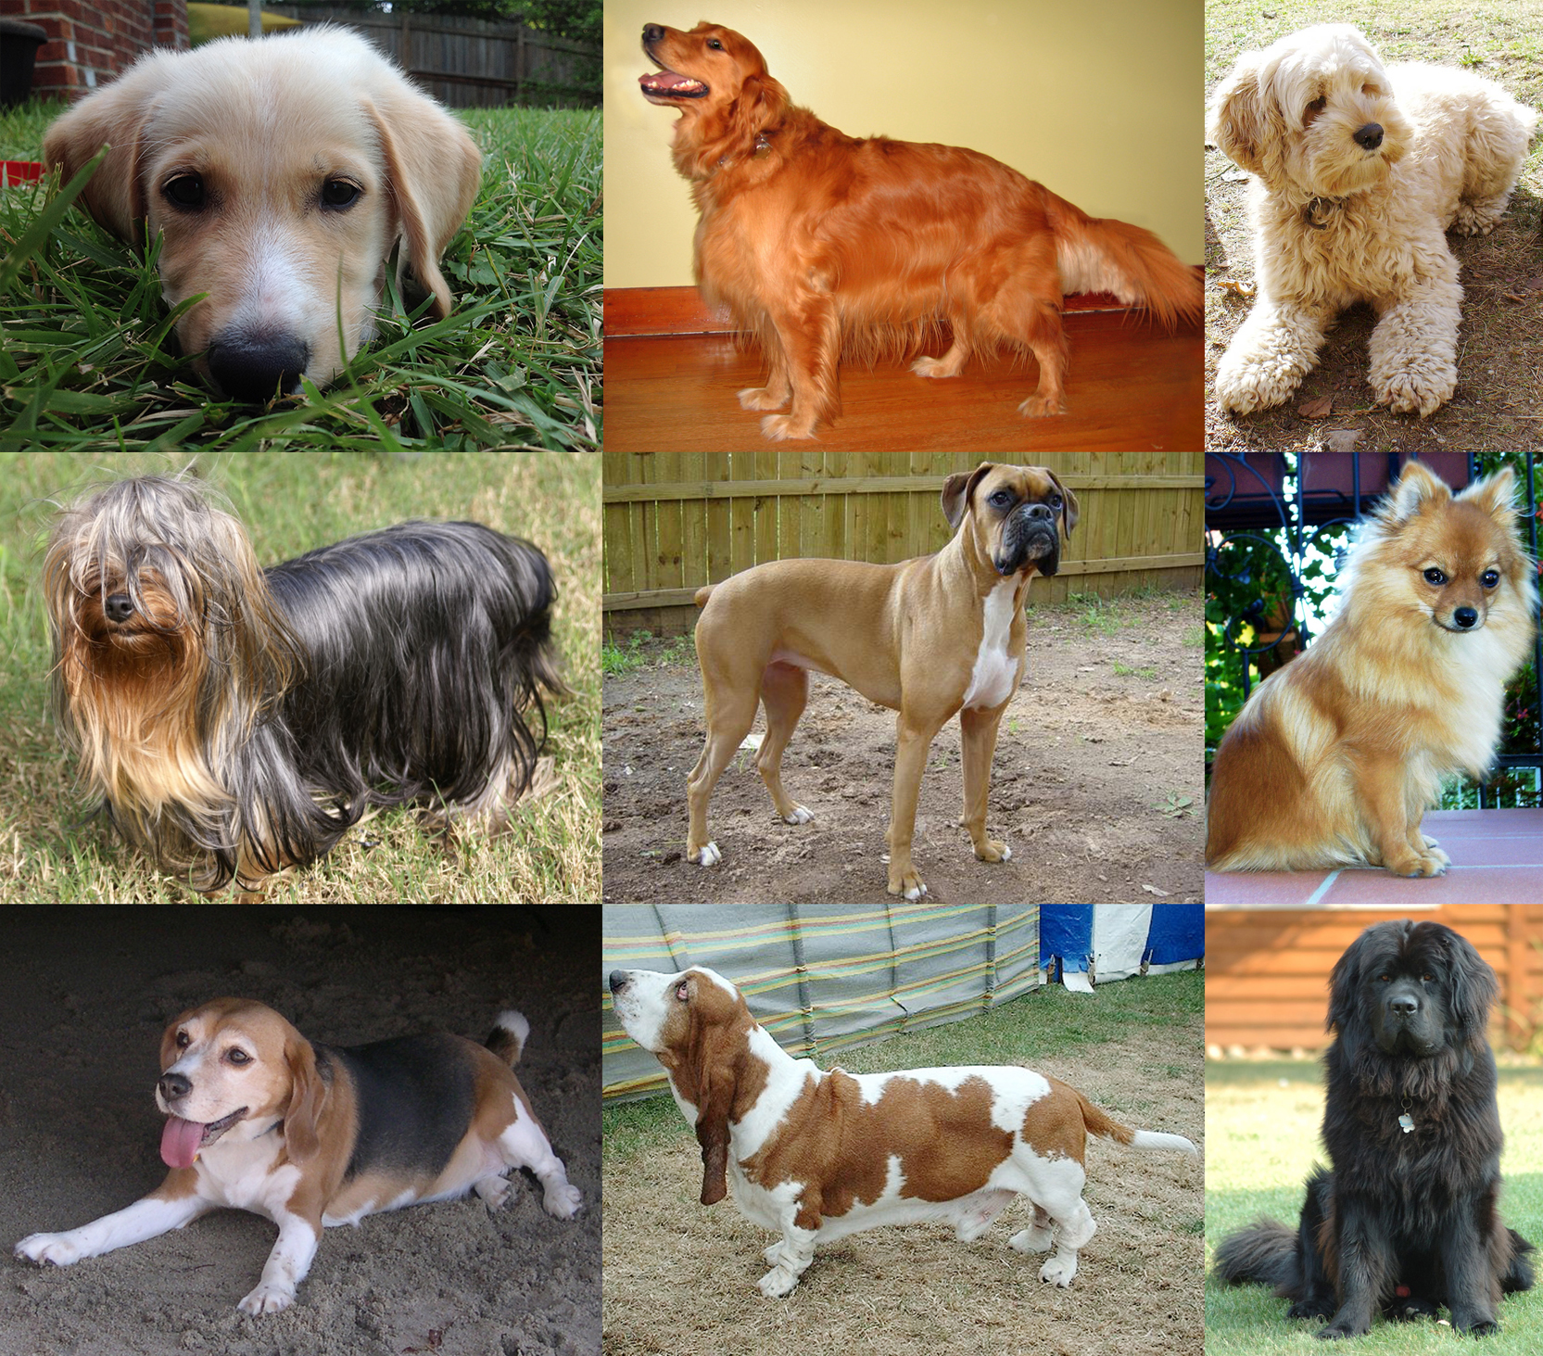
Multi-Class Example
Notes:
https://upload.wikimedia.org/wikipedia/commons/d/d9/Collage_of_Nine_Dogs.jpg

Slide 94
Multi-Class Example - Dogs
Height | Weight | Color | Dog Type
22 in | 62 lbs | Black | Black Lab
15 in | 45 lbs | White, brown | English Bulldog
9 in | 19 lbs | Black | Dachshund

Slide 95
Classification → Binary Classification
Is this tweet positive Is this tweet positive or not positive?
or negative?
Y = {pos, neg} Y = {1, 0}
y = argmax_{c} p(c|x, D) p(y=0 | x, D) = 1 – p(y=1 | x, D)

Slide 96
Classification vs. Binary Classification
Y = {1, 2, 3, …, n} Y = {1, 0}
y = argmax_{c} p(c|x, D) p(y=0 | x, D) = 1 – p(y=1 | x, D)
Determining the decade Positive or not positive tweets
of birth
Species of tree Is the road clear of obstructions?
Type of road sign

Slide 97
Classification vs. Binary Classification
Some methods are inherently capable of multi-class classification
Naïve Bayes - y = argmax_{c} p(c|x, D)
KNN – find N_{k}(x, D), assign the majority (plurality) label to x

Slide 98
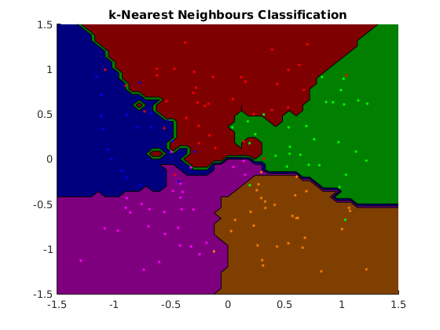
Multi-Class Classification - KNN
Notes:
https://www.cs.ubc.ca/~schmidtm/Software/matLearn/multiclass/demos/html/demo_multiclass_KNN_01.png

Slide 99
Classification vs. Binary Classification
Some methods are done as binary classification
Logistic Regression
Or are inherently binary
Perceptron
Support Vector Machines

Slide 100
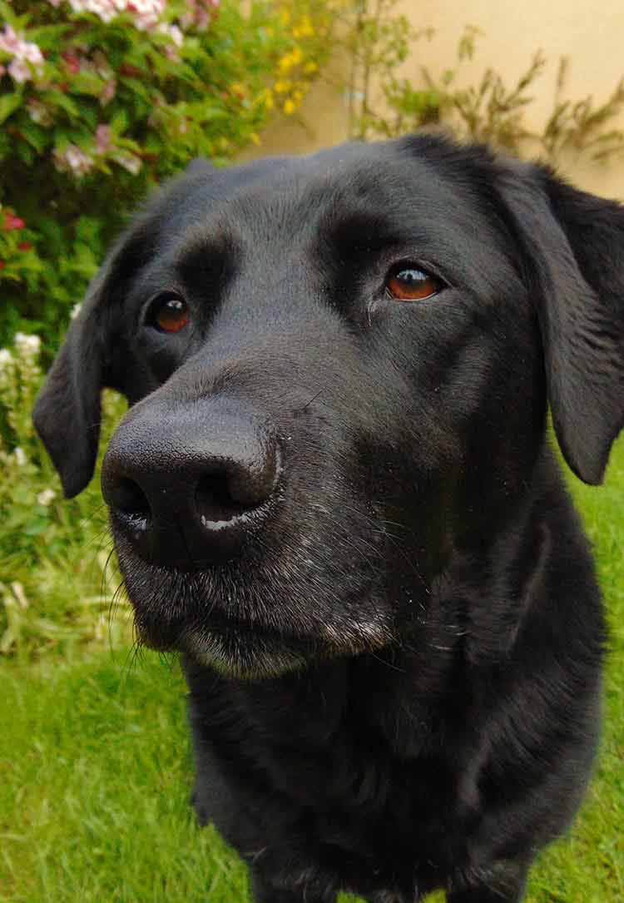
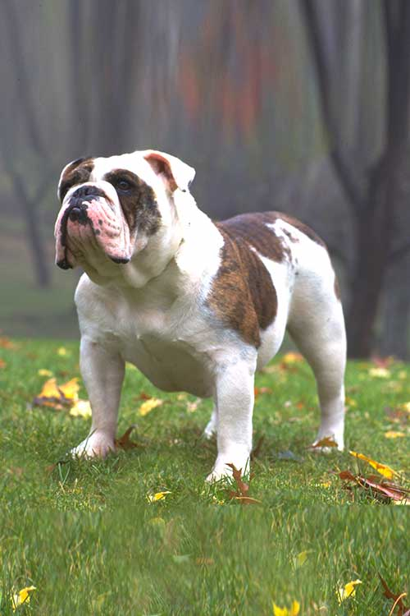
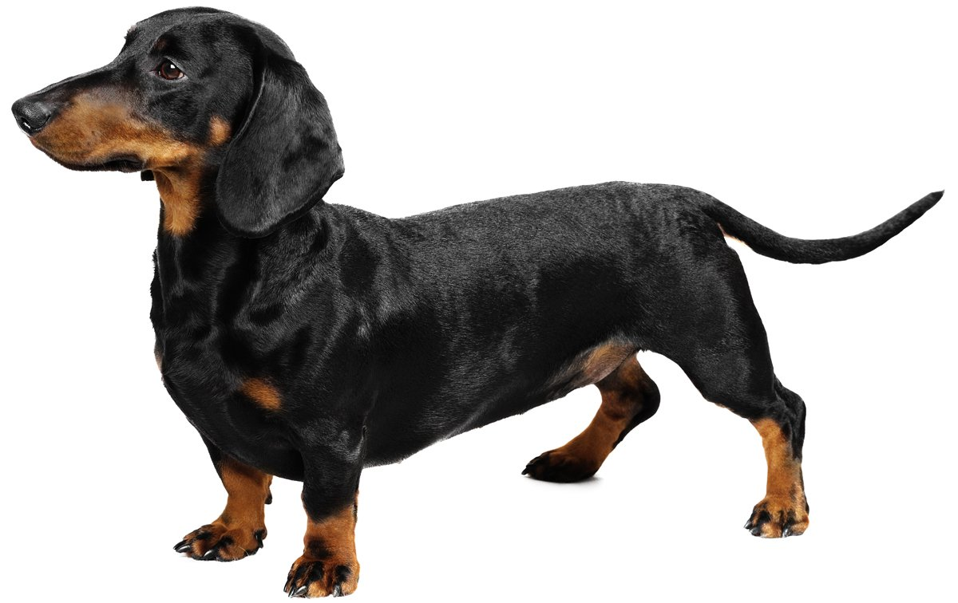
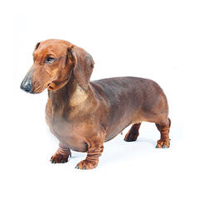
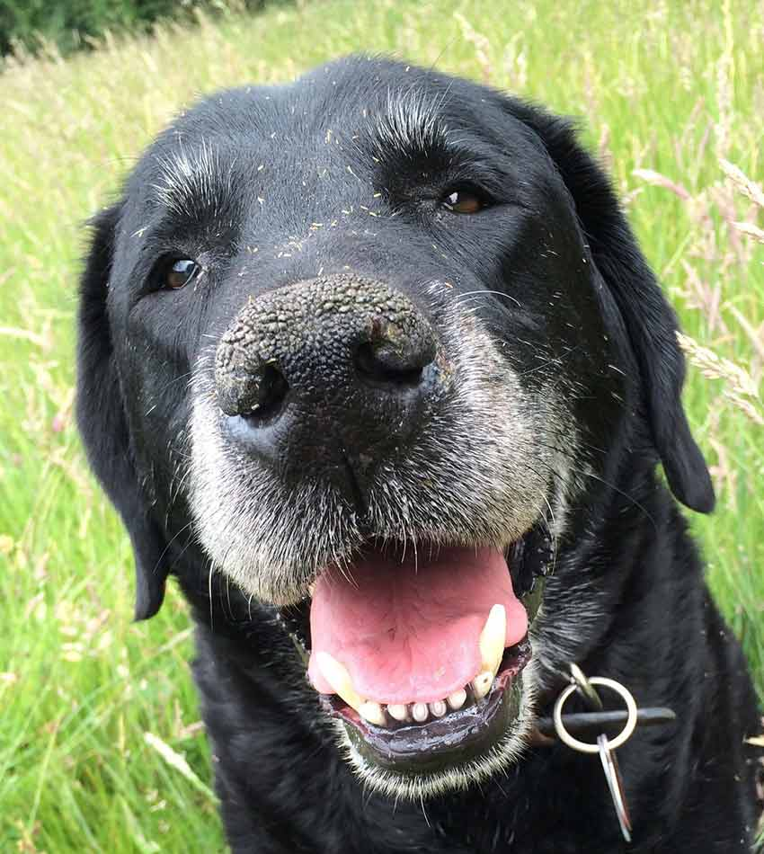
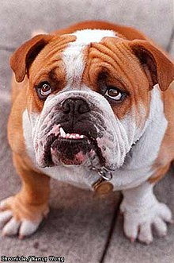
Multi-Class: One vs. All / One vs. Rest
For each class, we create a binary model
c vs. ~c
 | vs | vs | vs
 | - | - | +
 | + | - | -
 | - | + | -
Notes:
https://ybxzcgnc7b-flywheel.netdna-ssl.com/wp-content/uploads/2017/04/black-labs-loving-dogs.jpg
https://s3.amazonaws.com/cdn-origin-etr.akc.org/wp-content/uploads/2017/11/12235340/Bulldog-Care.jpg
https://cdn1-www.dogtime.com/assets/uploads/2011/01/file_23020_dachshund-dog-breed.jpg
https://www.purina.com/sites/g/files/auxxlc196/files/styles/kraken_generic_max_width_240/public/HOUND_Dachshund-%28Smooth%29.jpg?itok=DzMsCGPV
https://ybxzcgnc7b-flywheel.netdna-ssl.com/wp-content/uploads/2017/04/old-black-lab.jpg
https://upload.wikimedia.org/wikipedia/commons/thumb/e/e5/Axel%2C_the_English_Bulldog.jpg/220px-Axel%2C_the_English_Bulldog.jpg

Slide 101
Multi-Class: One vs. Another (All-Pairs)
For each pair of classes, we create a binary model
1 vs. 2, 1 vs. 3, 2 vs. 3, 1 vs. 4, 2 vs. 4, 3 vs. 4, etc.
 | vs | vs | vs
 | ? | B | A
 | A | A | ?
 | B | ? | B
Notes:
https://ybxzcgnc7b-flywheel.netdna-ssl.com/wp-content/uploads/2017/04/black-labs-loving-dogs.jpg
https://s3.amazonaws.com/cdn-origin-etr.akc.org/wp-content/uploads/2017/11/12235340/Bulldog-Care.jpg
https://cdn1-www.dogtime.com/assets/uploads/2011/01/file_23020_dachshund-dog-breed.jpg
https://www.purina.com/sites/g/files/auxxlc196/files/styles/kraken_generic_max_width_240/public/HOUND_Dachshund-%28Smooth%29.jpg?itok=DzMsCGPV
https://ybxzcgnc7b-flywheel.netdna-ssl.com/wp-content/uploads/2017/04/old-black-lab.jpg
https://upload.wikimedia.org/wikipedia/commons/thumb/e/e5/Axel%2C_the_English_Bulldog.jpg/220px-Axel%2C_the_English_Bulldog.jpg

Slide 102
Training & Hold-Out & Test Sets
Train Data
Hold-Out Data
I pull out another random 20% of my data
I’m starting to run out of data… To Be Continued!
Test Data

Slide 103
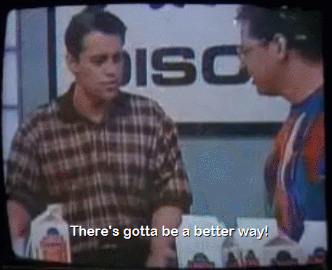
What’s in a test set?
Suddenly, you’ve got very little data with which to train

Slide 104
K-Fold Cross Validation
Create “folds” of your data, or K equal size groups
Training Data

Slide 105
K-Fold Cross Validation
Create “folds” of your data, or K equal size groups
Training Data
80%
Fold 1
Fold 2
Fold 3
Fold 4
Fold 5

Slide 106
K-Fold Cross Validation
Iterate through making each fold the validation set once
Accuracy = 11 / 20
Training Data
80%
Fold 1
Fold 2
Fold 3
Fold 4
Fold 5

Slide 107
K-Fold Cross Validation
Iterate through making each fold the validation set once
Accuracy = 17 / 20
Training Data
80%
Fold 1
Fold 2
Fold 3
Fold 4
Fold 5

Slide 108
K-Fold Cross Validation
Iterate through making each fold the validation set once
Accuracy = 16 / 20
Training Data
80%
Fold 1
Fold 2
Fold 3
Fold 4
Fold 5

Slide 109
K-Fold Cross Validation
Iterate through making each fold the validation set once
Accuracy = 13 / 20
Training Data
80%
Fold 1
Fold 2
Fold 3
Fold 4
Fold 5

Slide 110
K-Fold Cross Validation
Iterate through making each fold the validation set once
Accuracy = 16 / 20
Training Data
80%
Fold 1
Fold 2
Fold 3
Fold 4
Fold 5

Slide 111
K-Fold Cross Validation
Iterate through making each fold the validation set once
Trial | Accuracy
1 | 11/20
2 | 17/20
3 | 16/20
4 | 13/20
5 | 16/20

Slide 112
K-Fold Cross Validation
Iterate through making each fold the validation set once
Take the average of errors for each trial as your expected average
Trial | Accuracy
1 | 11/20
2 | 17/20
3 | 16/20
4 | 13/20
5 | 16/20

Slide 113
K-Fold Cross Validation
Iterate through making each fold the validation set once
Take the average of errors for each trial as your expected average
Error = .27, Accuracy = .73
Trial | Accuracy
1 | 11/20
2 | 17/20
3 | 16/20
4 | 13/20
5 | 16/20

Slide 114
K-Fold Cross Validation
Iterate through making each fold the validation set once
Take the average of errors for each trial as your expected average
Error = .27, Accuracy = .73
But do we trust this number?
Trial | Accuracy
1 | 11/20
2 | 17/20
3 | 16/20
4 | 13/20
5 | 16/20

Slide 115
K-Fold Cross Validation
Iterate through making each fold the validation set once
Take the standard error for our trials, 95% Confidence Interval is approximately +/- 2SE
Trial | Accuracy
1 | 11/20
2 | 17/20
3 | 16/20
4 | 13/20
5 | 16/20

Slide 116
K-Fold Cross Validation
Iterate through making each fold the validation set once
Take the standard error for our trials, 95% Confidence Interval is approximately +/- 2SE
2SE = .1, confidence interval = [.17, .37]
Trial | Accuracy
1 | 11/20
2 | 17/20
3 | 16/20
4 | 13/20
5 | 16/20

Slide 117
K in K-Fold Cross Validation
There’s no hard-and-fast rule, there’s no universally accepted solution
K = 5 or K = 10 are popular, but it also depends on your dataset size
People will do multiple rotations / bootstrapping as well.

Slide 118
Exercise – Logistic Regression
Classifying our Adult Dataset

Slide 119

Support Vector Machines
Notes:
https://media0.giphy.com/media/1MclE9Kaw3996/giphy.gif

Slide 120
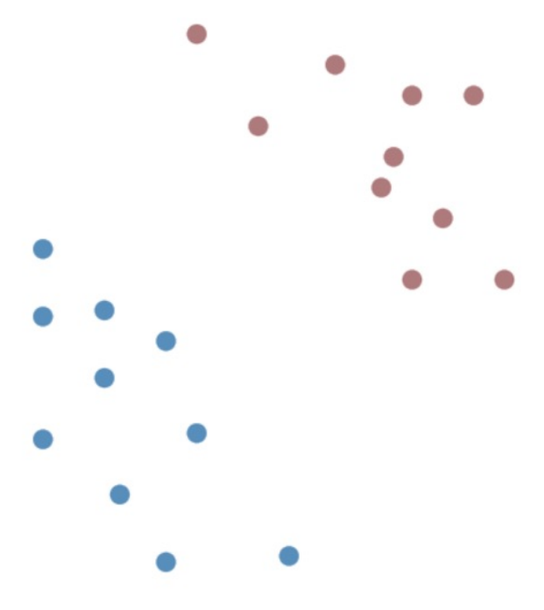
Classifying Points

Slide 121
Linear Classifier
A linear classifier:
- calculates a weighted sum (w^{T}x)
- classifies based on w^{T}x >= threshold

Slide 122
Linear Classifier
A linear classifier:
- calculates a weighted sum (w^{T}x + b)
- classifies based on w^{T}x + b >= 0

Slide 123
Linear Classifier
A linear classifier:
- calculates a weighted sum (w^{T}x + b)
- classifies based on w^{T}x + b >= 0
New Representation
C = {-1, 1}

Slide 124
Classifying Points – 1D
w^{T}x + b >= 0 → w₁x₁ + b

Slide 125
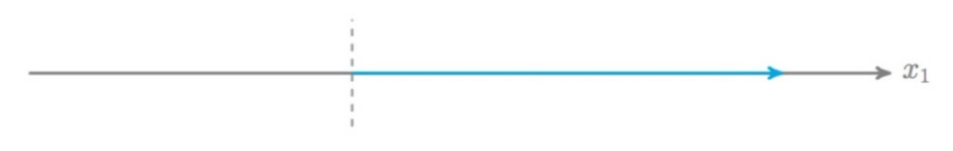
Classifying Points – 1D
w^{T}x + b >= 0 → w₁x₁ + b >= 0
x₁ >= -b / w₁

Slide 126
Classifying Points – 2D
w^{T}x + b >= 0 → w₁x₁ + w₂x₂ + b >= 0

Slide 127
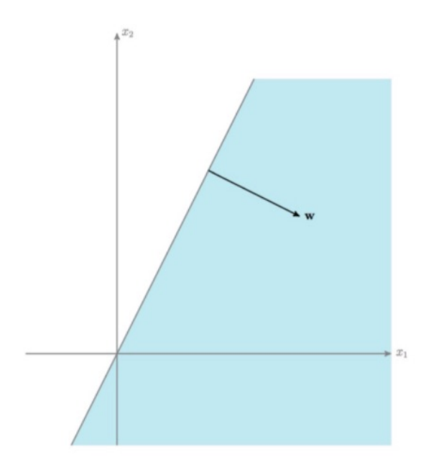
Classifying Points – 2D
w^{T}x + b >= 0 → w₁x₁ + w₂x₂ + b >= 0
X₂ >= -w₁x₁ - b
w₂

Slide 128
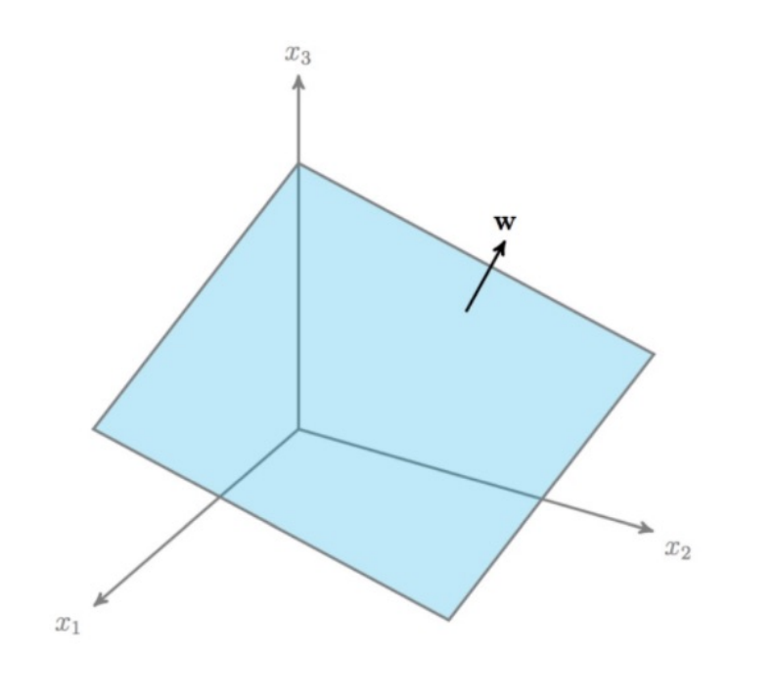
Classifying Points – 3D
Vector w is normal to the
decision boundary

Slide 129
Decision Boundary
What is our best decision boundary?

Slide 130
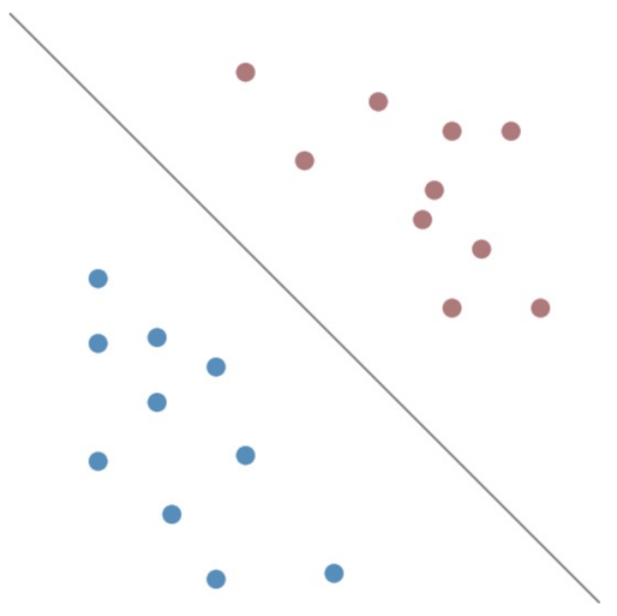
Best Decision Boundary
Why did we like this one the best?
Best gap boundary → examples
Biggest Margins

Slide 131
Best Decision Boundary
Why did we like this one the best?
Best gap boundary → examples
Biggest Margins
w^{T}x + b >> 0, very confident y_{i} = 1

Slide 132
Best Decision Boundary
Why did we like this one the best?
Best gap boundary → examples
Biggest Margins
w^{T}x + b << 0 , very confident y_{i} = -1

Slide 133
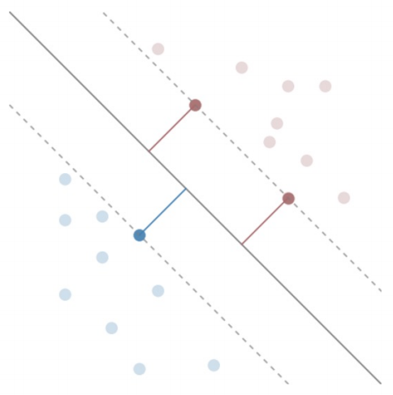
Best Decision Boundary
The Margin (M)
Distance DB → Closest Points
Support Vectors
closest Points to DB

Slide 134
Best Decision Boundary
Support Vectors
w^{T}x + b = ± 1

Slide 135
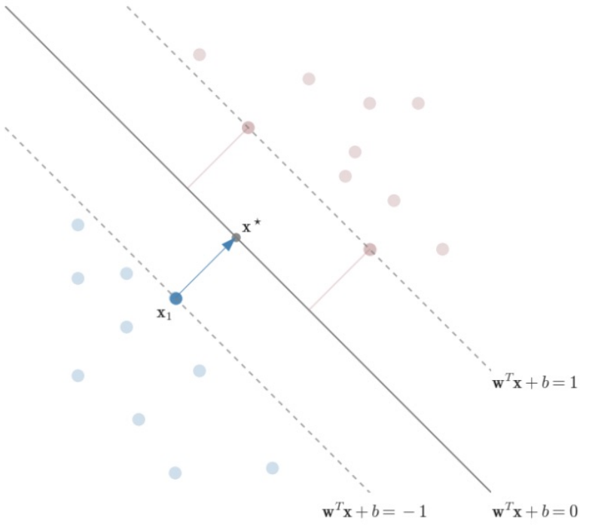
Maximizing our Margin

Slide 136
Maximizing our Margin
Choose support vector x₁
And closest point on DB x*
move from x₁ to x*
x* = x₁ + λw

Slide 137
Maximizing our Margin
Margin is distance moved
M = ||λw|| = λ||w||
x* is on the decision boundary
w^{T}x* + b = 0
x₁ is on the -1 boundary
w^{T}x₁ + b = -1

Slide 138
Maximizing our Margin
x* = x₁ + λw (1)
w^{T}x* + b = 0 (2)
w^{T}x₁ + b = -1 (3)

Slide 139
Maximizing our Margin
x* = x₁ + λw (1)
w^{T}x* + b = 0 (2)
w^{T}x₁ + b = -1 (3)
(1) Into (2)
w^{T} (x₁ + λw) + b = 0

Slide 140
Maximizing our Margin
x* = x₁ + λw (1)
w^{T}x* + b = 0 (2)
w^{T}x₁ + b = -1 (3)
(1) Into (2)
w^{T} (x₁ + λw) + b = 0 →
w^{T}x₁ + λ w^{T} w + b = 0 →
w^{T}x₁ + b + λ w^{T} w = 0 (4)

Slide 141
Maximizing our Margin
x* = x₁ + λw (1)
w^{T}x* + b = 0 (2)
w^{T}x₁ + b = -1 (3)
(1) Into (2)
w^{T} (x₁ + λw) + b = 0 →
w^{T}x₁ + λ w^{T} w + b = 0 →
w^{T}x₁ + b + λ w^{T} w = 0 (4)
(3) Into (4)
-1 + λ w^{T} w = 0 → λ w^{T} w = 1 (5)

Slide 142
Maximizing our Margin
Norm w (||w||) is the magnitude of w
||w|| = √(w₁²+ w₂²+ w₃²+…+ w_{n}²)
Dot Product of a vector with itself (transposed) is the norm squared
||w||² = (w₁²+ w₂²+ w₃²+…+ w_{n}²) = w^{T}w (6)

Slide 143
Maximizing our Margin
x* = x₁ + λw (1)
w^{T}x* + b = 0 (2)
w^{T}x₁ + b = -1 (3)
(1) Into (2)
w^{T} (x₁ + λw) + b = 0 →
w^{T}x₁ + λ w^{T} w + b = 0 →
w^{T}x₁ + b + λ w^{T} w = 0 (4)
(3) Into (4)
-1 + λ w^{T} w = 0 → λ w^{T} w = 1 (5)
||w||² = w^{T}w (6)
(6) Into (5)
λ ||w||² = 1

Slide 144
Maximizing our Margin
x* = x₁ + λw (1)
w^{T}x* + b = 0 (2)
w^{T}x₁ + b = -1 (3)
(1) Into (2)
w^{T} (x₁ + λw) + b = 0 →
w^{T}x₁ + λ w^{T} w + b = 0 →
w^{T}x₁ + b + λ w^{T} w = 0 (4)
(3) Into (4)
-1 + λ w^{T} w = 0 → λ w^{T} w = 1 (5)
||w||² = w^{T}w (6)
(6) Into (5)
λ ||w||² = 1 (7)
M = ||λw|| = λ||w|| (8)
(8) Into (7)
M = 1 / ||w||

Slide 145
Best Decision Boundary
argmax_{w, b} (M) such that points are classified correctly

Slide 146
Best Decision Boundary
argmax_{w, b} (M) such that points are classified correctly
argmax_{w, b} (1 / ||w||) such that points are classified correctly

Slide 147
Best Decision Boundary
argmax_{w, b} (M) such that points are classified correctly
argmax_{w, b} (1 / ||w||) such that points are classified correctly
w^{T}x_{i} + b <= -1 if y_{i} = -1
w^{T}x_{i} + b >= 1 if y_{i} = 1

Slide 148
Best Decision Boundary
argmax_{w, b} (M) such that points are classified correctly
argmax_{w, b} (1 / ||w||) such that points are classified correctly
w^{T}x_{i} + b <= -1 if y_{i} = -1
w^{T}x_{i} + b >= 1 if y_{i} = 1
y_{i}(w^{T}x_{i} + b) >= 1 for i = {1,2,…,m}

Slide 149
Best Decision Boundary
argmax_{w, b} (1 / ||w||) such that y_{i}(w^{T}x_{i} + b) >= 1 for i = {1,2,…,m}
Optimize to find w, b

Slide 150
Best Decision Boundary
argmax_{w, b} (1 / ||w||) such that y_{i}(w^{T}x_{i} + b) >= 1 for i = {1,2,…,m}
Optimize to find w, b
But it’s not differentiable! (i.e. we can’t find a gradient vector)

Slide 151
Best Decision Boundary
argmax_{w, b} (1 / ||w||) such that y_{i}(w^{T}x_{i} + b) >= 1 for i = {1,2,…,m}
Not Differentiable
argmin_{w, b} (||w||) such that y_{i}(w^{T}x_{i} + b) >= 1 for i = {1,2,…,m}

Slide 152
Best Decision Boundary
argmax_{w, b} (1 / ||w||) such that y_{i}(w^{T}x_{i} + b) >= 1 for i = {1,2,…,m}
Not Differentiable
argmin_{w, b} (||w||) such that y_{i}(w^{T}x_{i} + b) >= 1 for i = {1,2,…,m}
Not Differentiable

Slide 153
Best Decision Boundary
Support Vectors
w^{T}x + b = ± 1
DB is unaffected by scale
(2w)^{T}x + 2b = 0

Slide 154
Best Decision Boundary
argmax_{w, b} (1 / ||w||) such that y_{i}(w^{T}x_{i} + b) >= 1 for i = {1,2,…,m}
Not Differentiable
argmin_{w, b} (||w||) such that y_{i}(w^{T}x_{i} + b) >= 1 for i = {1,2,…,m}
Not Differentiable
argmin_{w, b} (||w||²) such that y_{i}(w^{T}x_{i} + b) >= 1 for i = {1,2,…,m}
Convex + Differentiable
Requires a Convex quadratic program

Slide 155
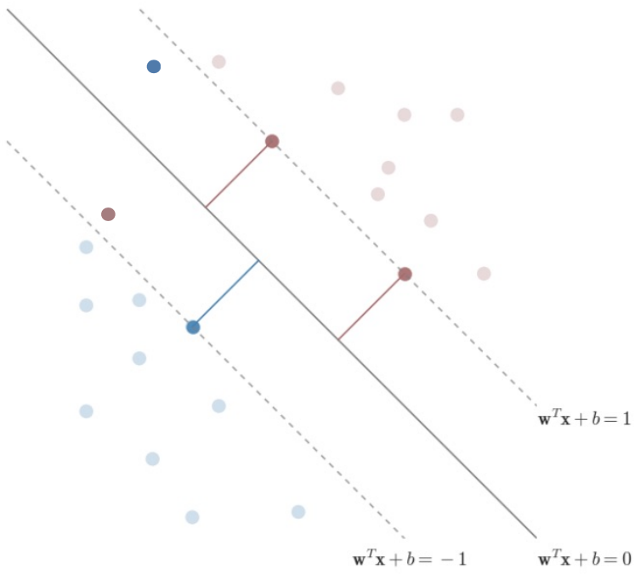
Shortcomings of Hard-Margin SVM
What if Linear Separability does not apply?

Slide 156
Interlude - Soft-Margin SVMs

Slide 157
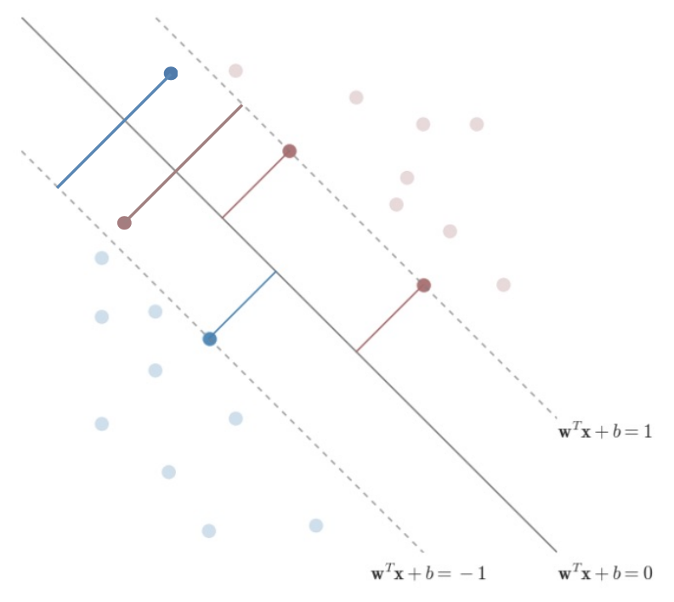
Overcoming Linear Separability Problem
Add some wiggle room to our
problem space

Slide 158
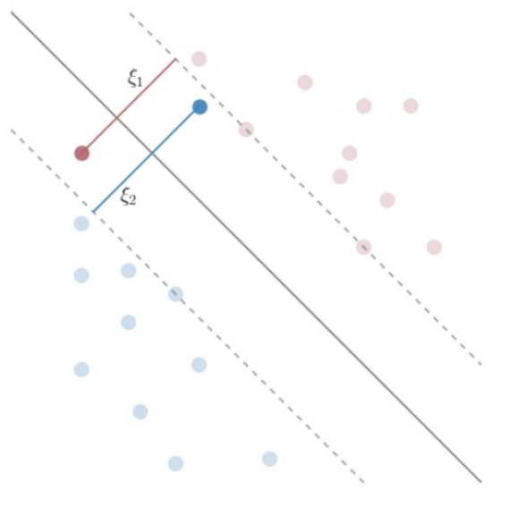
Adding a slack term ξ
Add a slack term ξ to every example
(for most examples the ξ is 0)

Slide 159
Adding a slack term ξ – Objective Function
argmin_{w, b} (½||w||²) → argmin_{w, b} (½||w||²) + C ∑_{i=1→m} ξ_{i}^{p}
C = Tuning Parameter
p = scaling of wrongness
p = 1 is often used

Slide 160
Adding a slack term ξ - Constraints
y_{i}(w^{T}x_{i} + b) >= 1 → y_{i}(w^{T}x_{i} + b) >= 1 – ξ_{i}
ξ_{i} relates to distance from the correct margin
ξ_{i} = 0 when we are on the correct side
(or on the boundary) of our margin
ξ_{i} = ½ when we are halfway between margin
and decision boundary
ξ_{i} = 2 when we are 1 margin on the wrong
side of the decision boundary

Slide 161
Adding a slack term ξ - Lagrangian
L(w,b,α) = (½||w||² + ∑_{i=1…m} (α_{i} (1 – y_{i}(w^{T}x_{i} + b)))) →
L(w,b,α,ξ)= (½||w||² - ∑_{i=1…m} (α_{i} (y_{i}(w^{T}x_{i} + b) – 1 + ξ_{i}))) - ∑_{i=1…m} β_{i}ξ_{i}
Add ξ as a term to minimize…

Slide 162
Adding a slack term ξ - Lagrangian
L(w,b,α) = (½||w||² + ∑_{i=1…m} (α_{i} (1 – y_{i}(w^{T}x_{i} + b)))) →
L(w,b,α,ξ)=(½||w||² - ∑_{i=1…m} (α_{i} (y_{i}(w^{T}x_{i} + b) – 1 + ξ_{i}))) - ∑_{i=1…m} β_{i}ξ_{i}
Add ξ as a term to minimize…
----------------------------------- Magic Happens -------------------------------------
max_{α} (∑_{i} α_{i} − ½ ∑_{i,j} α_{i} α_{j} y_{i} y_{j} x_{i} · x_{j}) – unchanged
New constraint: 0 <= α <= C

Slide 163
Adding a slack term ξ – Final Form
max_{α} (L_{D}) = max_{α} (∑_{i} α_{i} − ½ ∑_{i,j} α_{i} α_{j} y_{i} y_{j} x_{i} · x_{j})
α_{i} = C if y_{i}(w^{T}x_{i} + b) < 1
C > α_{i} > 0 if y_{i}(w^{T}x_{i} + b) = 1
α_{i} = 0 if y_{i}(w^{T}x_{i} + b) > 1

Slide 164
Maximizing our Margin
max_{α} (∑_{i} α_{i} − ½ ∑_{i,j} α_{i} α_{j} y_{i} y_{j} x_{i} · x_{j})
α_{i} > 0 if y_{i}(w^{T}x_{i} + b) = 1
α_{i} = 0 if y_{i}(w^{T}x_{i} + b) < 1

Slide 165
(Finally) Calculating our Maximum

Slide 166
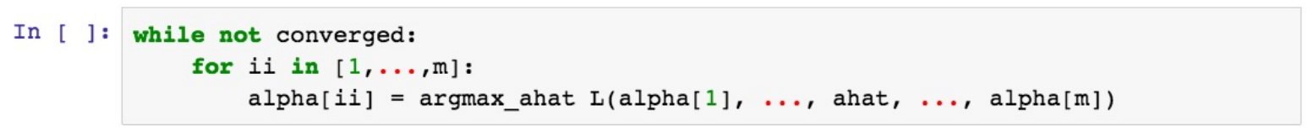
Coordinate Ascent
L(α_{i=1→m}) = (∑_{i} α_{i} − ½ ∑_{i,j} α_{i} α_{j} y_{i} y_{j} x_{i} · x_{j})
Change α_{i} to make L(α) as big as possible

Slide 167
Coordinate Ascent
L(α_{i=1→m}) = (∑_{i} α_{i} − ½ ∑_{i,j} α_{i} α_{j} y_{i} y_{j} x_{i} · x_{j})
Change α_{i} to make L(α) as big as possible
0 = ∑_{i=1→m} α_{i} y_{i}
We can’t change α_{i} one at a time!

Slide 168
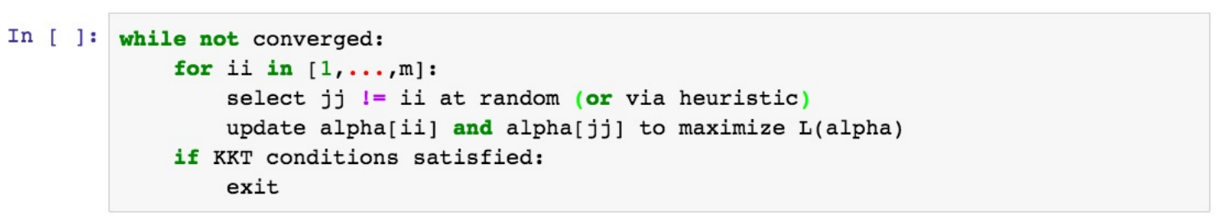
Sequential Minimal Optimizer
L(α_{i=1→m}) = (∑_{i} α_{i} − ½ ∑_{i,j} α_{i} α_{j} y_{i} y_{j} x_{i} · x_{j})
Change α_{i}, α_{j} to make L(α) as big as possible
0 = ∑_{i=1→m} α_{i} y_{i}

Slide 169
Sequential Minimal Optimizer
Change α_{i}, α_{j} to make L(α) as big as possible
0 = ∑_{i=1→m} α_{i} y_{i}
0 = α₁ y₁ + α₂ y₂ + ∑_{k=3→m} α_{k} y_{k}

Slide 170
Sequential Minimal Optimizer
Change α_{i}, α_{j} to make L(α) as big as possible
0 = ∑_{i=1→m} α_{i} y_{i}
0 = α₁ y₁ + α₂ y₂ + ∑_{k=3→m} α_{k} y_{k}
α_{i} y_{i} + α_{j} y_{j} = - ∑_{k!=i,j} α_{k} y_{k} = δ

Slide 171
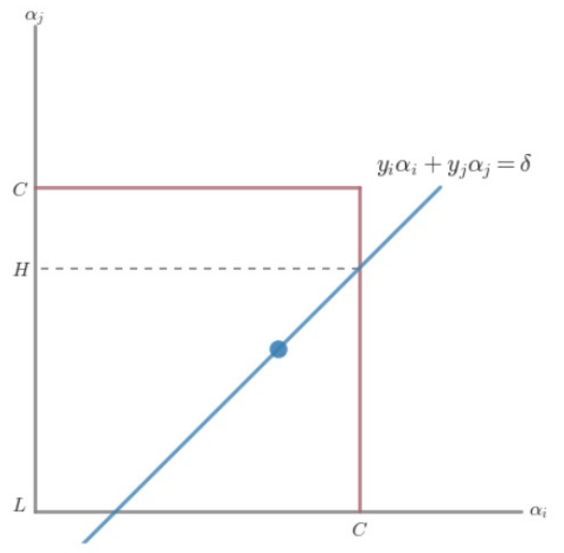
Sequential Minimal Optimizer
α_{i} y_{i} + α_{j} y_{j} = - ∑_{k!=i,j} α_{k} y_{k} = δ
0 <= α_{i} <= C

Slide 172
Sequential Minimal Optimizer
α_{i} y_{i} + α_{j} y_{j} = - ∑_{k!=i,j} α_{k} y_{k} = δ
0 <= α_{i} <= C
y_{i} != y_{j} y_{i} = y_{j}
L = max(0, α_{j} – α_{i}) or max(0, α_{j} + α_{i} – C)
H = min(C, C + α_{j} – α_{i}) or min(C, α_{j} + α_{i})

Slide 173
Sequential Minimal Optimizer
H if α_{j} > H
α_{j} = α_{j} if L <= α_{j} <= H
L if α_{j} < L
α_{i} such that α_{i} y_{i} + α_{j} y_{j} = - ∑_{k!=i,j} α_{k} y_{k} = δ

Slide 174
Sequential Minimal Optimizer
H if α_{j} > H
α_{j} = α_{j} if L <= α_{j} <= H
L if α_{j} < L
α_{i} such that α_{i} y_{i} + α_{j} y_{j} = - ∑_{k!=i,j} α_{k} y_{k} = δ

Slide 175
Shortcomings of Soft-Margin SVM
We added some wiggle room

Slide 176
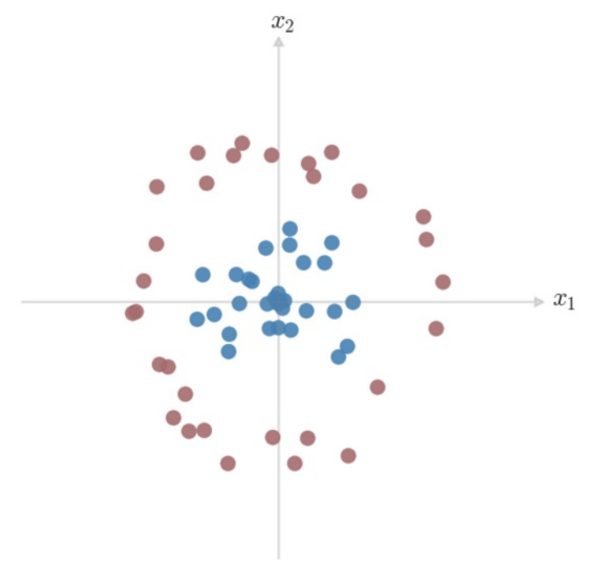
Shortcomings of Soft-Margin SVM
We added some wiggle room
But what if it’s not linearly separable?

Slide 177
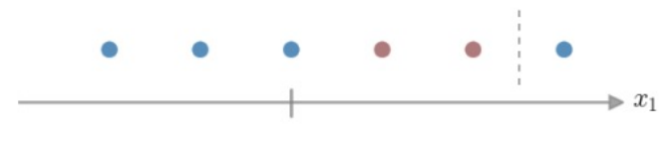
Linear Inseparability – 1D Case

Slide 178
Linear Inseparability – 1D Case
Your arterial blood’s pH should be between 7.35 and 7.45
Otherwise, you’re unhealthy (for some reason), we should run further tests.
https://www.maximumfun.org/sawbones/sawbones-alkaline-water
https://opentextbc.ca/anatomyandphysiology/chapter/26-5-disorders-of-acid-base-balance/

Slide 179
Linear Inseparability – 1D Case
What can we do to capture this idea?

Slide 180
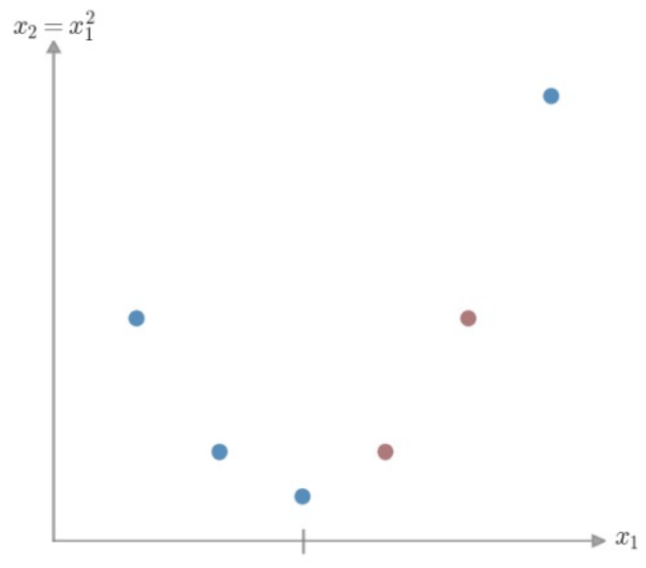
Linear Inseparability – 1D Case
Project our data into a higher dimensional space

Slide 181
Linear Inseparability – Dimension Projection
Start with our initial feature vector x = [x₁]
Create an augmented feature vector φ(x) = [x₁, x₁²]

Slide 182
Linear Inseparability – Dimension Projection
Start with our initial feature vector x = [x₁]
Create an augmented feature vector φ(x) = [x₁, x₁²]
Replace x with φ(x) in our optimization problem!

Slide 183
Our Optimization Problem
(∑_{i} α_{i} − ½ ∑_{i,j} α_{i} α_{j} y_{i} y_{j} x_{i} · x_{j})

Slide 184
Our Optimization Problem
(∑_{i} α_{i} − ½ ∑_{i,j} α_{i} α_{j} y_{i} y_{j} x_{i} · x_{j})
(∑_{i} α_{i} − ½ ∑_{i,j} α_{i} α_{j} y_{i} y_{j} φ(x)_{i} · φ(x)_{j})

Slide 185
Dimension Projection
How would we separate these classes?

Slide 186
Dimension Projection - Circle
How would we separate these classes?
We think in terms of sides of a boundary…

Slide 187
Dimension Projection
How would we separate these classes?
What kind of boundary can we give
this space?
Can we express that boundary in
terms of our given features?

Slide 188
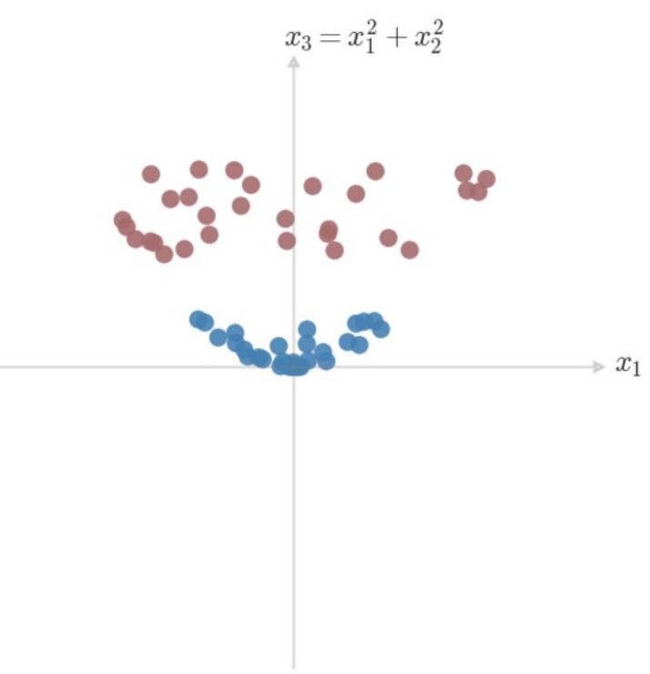
Dimension Projection
How would we separate these classes?
What kind of boundary can we give
this space?
Can we express that boundary in
terms of our given features?

Slide 189
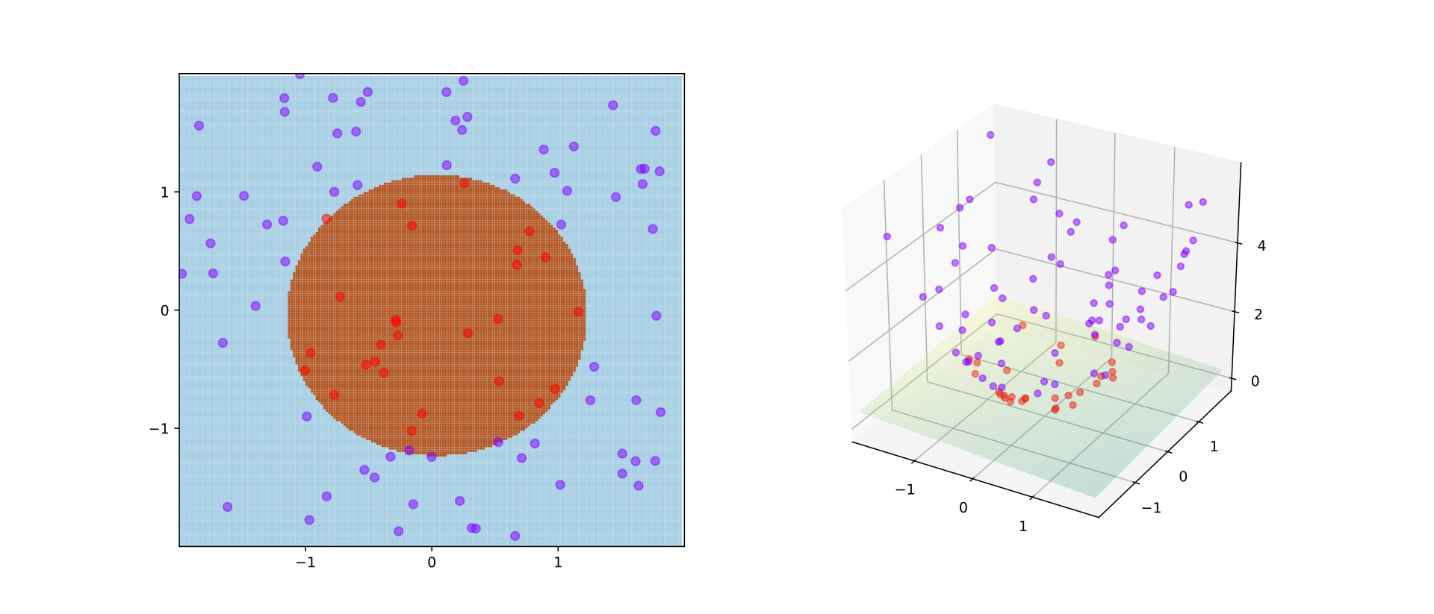
Dimension Projection - Circle
Notes:
https://en.wikipedia.org/wiki/Kernel_method#/media/File:Kernel_trick_idea.svg

Slide 190
Linear Inseparability – Dimension Projection
Start with our initial feature vector x = [x₁, x₂]
Create an augmented feature vector φ(x) = [x₁, x₂, x₁² + x₂²]
Replace x with φ(x) in our optimization problem!
Decision Boundary is a plane in 3D Space
x₁² + x₂² = constant

Slide 191
Our Optimization Problem
(∑_{i} α_{i} − ½ ∑_{i,j} α_{i} α_{j} y_{i} y_{j} x_{i} · x_{j})
(∑_{i} α_{i} − ½ ∑_{i,j} α_{i} α_{j} y_{i} y_{j} φ(x)_{i} · φ(x)_{j})

Slide 192
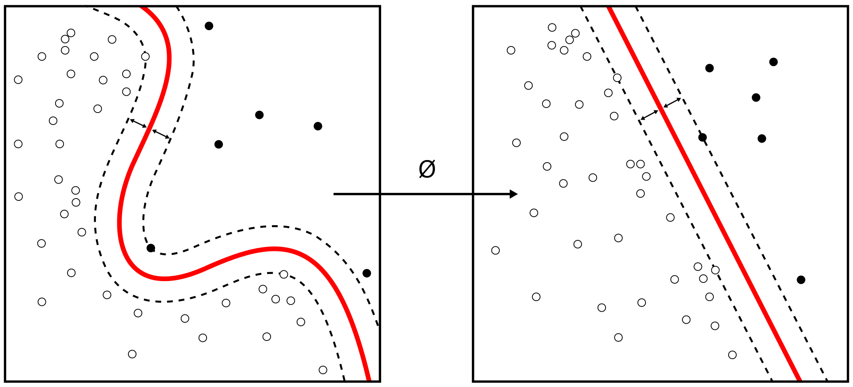
Generalizing our Optimization
Notes:
https://en.wikipedia.org/wiki/Kernel_method#/media/File:Kernel_Machine.svg

Slide 193
Our Optimization Problem – In Practice
For a 3-Dimensional Case…
X = [x₁,x₂,x₃]
φ(x) = (x_{i}^{T}x_{j})²

Slide 194
Linear Inseparability – 1D Case
Project our data into a higher dimensional space

Slide 195
Our Optimization Problem – In Practice
For a 3-Dimensional Case…
X = [x₁,x₂,x₃]
φ(x) = (x_{i}^{T}x_{j})²
φ[X] = [x₁ x₁, x₁ x₂, x₁ x₃, x₂ x₁, x₂ x₂, x₂ x₃, x₃ x₁, x₃ x₂, x₃ x₃]

Slide 196
Generalizing our Optimization – Curse of Dimensionality
Take a 64-feature vector
Transform it using φ(x) = (x_{i}^{T}x_{j})²
How many dimension do I have?

Slide 197
Our Optimization Problem
(∑_{i} α_{i} − ½ ∑_{i,j} α_{i} α_{j} y_{i} y_{j} x_{i} · x_{j})
(∑_{i} α_{i} − ½ ∑_{i,j} α_{i} α_{j} y_{i} y_{j} φ(x)_{i} · φ(x)_{j})
Redefine φ(x)_{i} · φ(x)_{j} as K(x, z) (x_{i} becomes x, x_{j} becomes z)*
*there are restrictions on this mapping – we’ll get there!

Slide 198
Our Optimization Problem – In Practice
x, z are vectors of real numbers in N-Dimensional Space
K(x, z) = (x^{T}z)²

Slide 199
Our Optimization Problem – In Practice
x, z are vectors of real numbers in N-Dimensional Space
K(x, z) = (x^{T}z)²
K(x, z) = (∑_{i=1→n} (x_{i}z_{i})) (∑_{j=1→n} (x_{j}z_{j}))

Slide 200
Our Optimization Problem – In Practice
x, z are vectors of real numbers in N-Dimensional Space
K(x, z) = (x^{T}z)²
K(x, z) = (∑_{i=1→n} (x_{i}z_{i})) (∑_{j=1→n} (x_{j}z_{j}))
= ∑_{i=1→n} ∑_{j=1→n}(x_{i}z_{i}x_{j}z_{j})
= ∑_{i,j=1→n}(x_{i}z_{i}x_{j}z_{j})
(∑_{i} α_{i} − ½ ∑_{i,j} α_{i} α_{j} y_{i} y_{j} (x_{i}z_{i}x_{j}z_{j}))

Slide 201
Kernels Save Time!
Computing φ(x) = (x_{i}^{T}x_{j})² takes O(n²)
Computing K(x,z) takes O(n)

Slide 202
Boundaries of Valid Kernels
For any set of points (x_{m}), you can store K(x_{i},x_{j}) in an m by m matrix K

Slide 203
Boundaries of Valid Kernels - Symmetry
For any set of points (x_{m}), you can store K(x_{i},x_{j}) in an m by m matrix K
K_{ij} = K(x^{i}) , x^{j} ) = φ(x^{i}))^{T} φ(x^{j}) = φ(x^{j})^{T} φ(x^{i}) = K(x^{j} , x^{i}) = K_{ji}
K must be symmetric

Slide 204
Boundaries of Valid Kernels – Positive Semi-Definite
For any set of points (x_{m}), you can store K(x_{i},x_{j}) in an m by m matrix K
z^{T}Kz $≥$ 0

Slide 205
Boundaries of Valid Kernels – Mercer’s Theorem
Theorem (Mercer). Let K : R^{n} × R^{n} → ℝ be given. Then for K to be a valid (Mercer) kernel, it is necessary and sufficient that for any {x¹, . . . , x^{m}}, (m < ∞), the corresponding kernel matrix is symmetric positive semi-definite.

Slide 206
Kernels Intuition
Dot product x · y tells you about the similarity between x and y
If both vectors are positive along a dimension, dot product will grow
If one vector is 0 along a dimension, dot product does not grow
If vectors are opposite signs along a dimension, dot product will shrink
Kernels just add dimension combinations to dot product!

Slide 207
Popular Kernels
Linear Kernel: K(x, z) = (x^{T}z)

Slide 208
Popular Kernels
Linear Kernel: K(x, z) = (x^{T}z)
Polynomial Kernel: K(x, z) = (x^{T}z + c)^{p}

Slide 209
Popular Kernels
Linear Kernel: K(x, z) = (x^{T}z)
Polynomial Kernel: K(x, z) = (x^{T}z + c)^{p}
Radial Basis Function(RBF) Kernel: K(x, z) = exp(- γ||x − z||²)

Slide 210
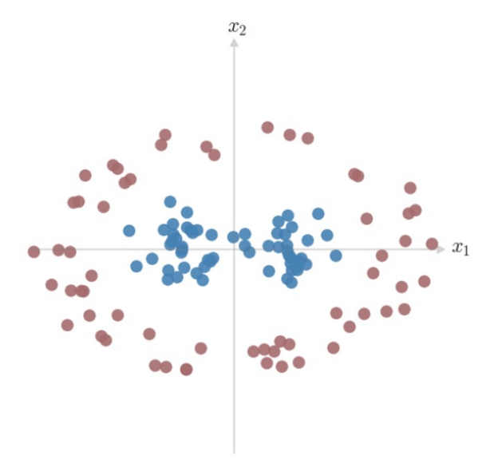
RBF Kernel for SVM

Slide 211
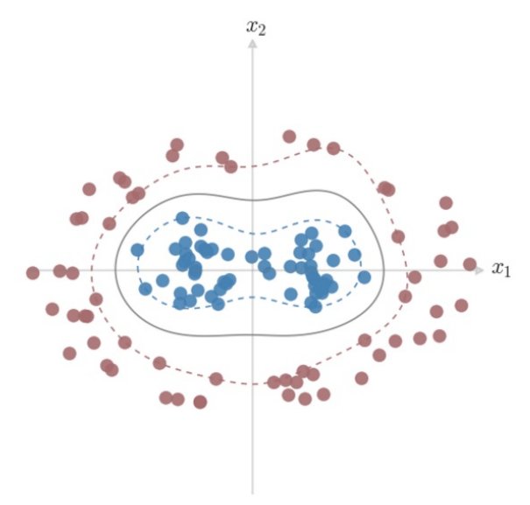
RBF Kernel for SVM
γ = 3
C = 5

Slide 212
Popular Kernels
Linear Kernel: K(x, z) = (x^{T}z)
Polynomial Kernel: K(x, z) = (x^{T}z + c)^{p}
Radial Basis Function(RBF) Kernel: K(x, z) = exp(- γ||x − z||²)
Gaussian RBF Kernel: K(x, z) = exp((- ||x − z||² ) / 2σ² )

Slide 213
SVM + Kernels
Pros
Works great “out-of-the-box”
Maintains convex objective function – guaranteed optimal solution
Solutions are sparse thanks to Kernels
Flexibly map to arbitrary decision boundary

Slide 214
SVM + Kernels
Pros
Works great “out-of-the-box”
Maintains convex objective function – guaranteed optimal solution
Solutions are sparse thanks to Kernels
Flexibly map to arbitrary decision boundary
Cons
Optimization can be slow
Choosing a Kernel is manual

Slide 215
Exercise – SVMs and Kernels

Slide 216
Perceptrons

Slide 217
Linear Classification Task
w^{T}x + b → ± 1
If w^{T}x + b > 0, y = 1
If w^{T}x + b < 0, y = -1
w^{T}x + b = 0 is an edge case

Slide 218
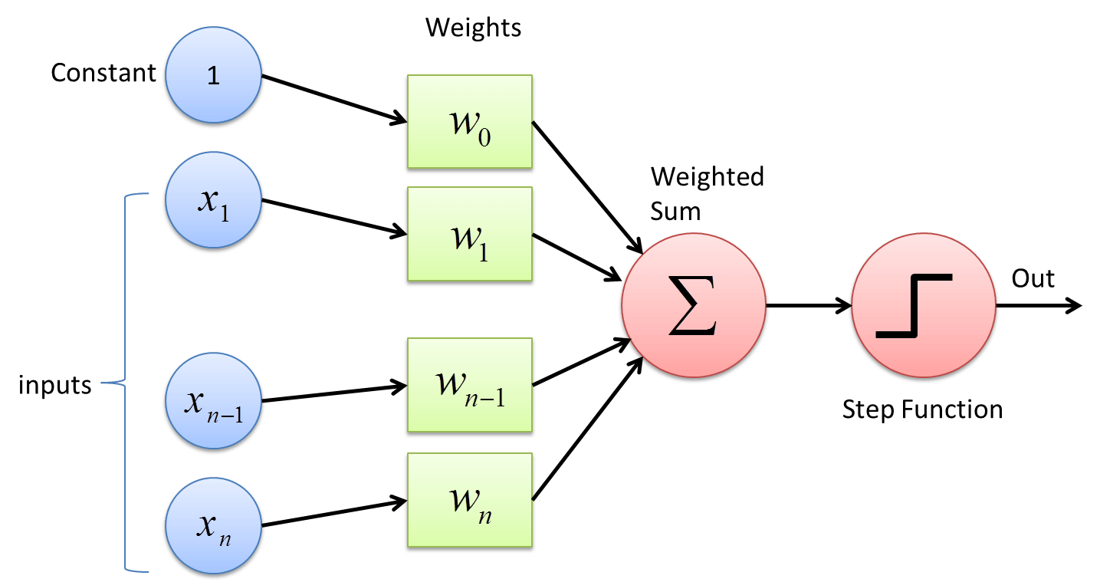
Visualizing Classification – The Perceptron
w^{T}x + b → ± 1
If w^{T}x + b > 0, y = 1
If w^{T}x + b < 0, y = -1
Notes:
https://cdn-images-1.medium.com/max/1600/1*n6sJ4yZQzwKL9wnF5wnVNg.png

Slide 219
Training a Perceptron – “Online” Learning
Initialize w to an all-zero vector.
For some fixed number of iterations, or until some stopping criterion is met:
For each training example xᵢ with ground truth label yᵢ ∈ {-1, 1}:
Let ŷ = sign(w^{T} xᵢ).
If ŷ ≠ yᵢ, update w ← w + yᵢ xᵢ.

Slide 220
Kernel Perceptron
Perform our Kernel transformation of our data, then generate our perceptron!

Slide 221
Kernel Perceptron
Create the matrix of our Kernel representation of our data
Linear Kernel: K(x, z) = (x^{T}z)
Polynomial Kernel: K(x, z) = (x^{T}z + c)^{p}
Radial Basis Function(RBF) Kernel: K(x, z) = exp(- γ||x − z||²)
Gaussian RBF Kernel: K(x, z) = exp((- ||x − z||² ) / 2σ² )

Slide 222
Training our Perceptron (Fit)
We no longer have “weights” to train on…

Slide 223
Training our Perceptron (Fit)
We no longer have “weights” to train on…
But we can use our Dual Expression of the problem!
∑_{i=1→n} α_{i}y_{i}K(x_{i},x_{j})
And use the same perceptron update as before, but increment our α by 1 each time.
If an example incremented α, then it’s a support vector

Slide 224
Feature Engineering

Slide 225
Problems With Data
Categorical Data

Slide 226
Categorical Data – Ways to Encode
Match to a corresponding numeric value
Color → R, G, B values (0 – 256)

Slide 227
Categorical Data – Ways to Encode
Match to a corresponding numeric value
Color → R, G, B values (0 – 256)
Will this work for every type of categorical data?
- choosing a piece of furniture to recommend based on room

Slide 228
Categorical Data – Ways to Encode
Create a new numeric value for each category
White | 1
Brown | 2
Gold | 3
Red | 4

Slide 229
Categorical Data – Ways to Encode
Create a new numeric value for each category
Problems?
White | 1
Brown | 2
Gold | 3
Red | 4

Slide 230
Categorical Data – Ways to Encode
Create a new binary feature (dummy variable) for each category
- one-hot encoding
Color | isWhite | isBrown | isGolden | isRed
White | 1 | 0 | 0 | 0
Golden | 0 | 0 | 1 | 0
Brown | 0 | 1 | 0 | 0
Red | 0 | 0 | 0 | 1

Slide 231
“Categorical” Data – Working with Time
Person | Time | isWorking
David | 2/6/2019 3PM | 1
Abigail | 2/6/2019 3PM | 0
David | 2/2/2019 12PM | 0
David | 2/4/2019 12PM | 1

Slide 232
“Categorical” Data – Working with Time
So many representations of time!
- 02/06/2019 3:40PM MST
- 06/02/2019 15:40 MST
- 201906021540
- 2019/06/02 22:40 GMT
- 1549492800
- 1549492800000

Slide 233
Working with Time
Time in Unix Timestamp
- Numerical

Slide 234
Working with Time
Person | Time | Timestamp | isWorking
David | 2/6/2019 3PM | X | 1
Abigail | 2/6/2019 3PM | X | 0
David | 2/2/2019 12PM | X – Y | 0
David | 2/4/2019 12PM | X – Z | 1

Slide 235


Working with Time
Breaking into multiple features
- e.g. “year”, “month”, “Day of Week”, “Date”, “Time (s)”
- Still some sense of numeric differences
- Allows you to capture cyclical events (seasons, holidays, …)
Notes:
https://www.thoughtco.com/thmb/kJpIUcqn8s37TLHjBR-oL4holGg=/768x0/filters:no_upscale():max_bytes(150000):strip_icc()/Konark-sun-temple-wheel-5b7b01d3c9e77c0050d37375.jpg
https://i0.wp.com/www.tor.com/wp-content/uploads/2015/06/wheel-of-time-snake-wheel-small.jpg?fit=740%2C+9999&crop=0%2C0%2C100%2C470px&ssl=1&w=640

Slide 236
Working with Time
Person | Time | Timestamp | Month | Day of Week | Date | Time | isWorking
David | 2/6/2019 3PM | X | 2 | 4 | 6 | 15 | 1
Abigail | 2/6/2019 3PM | X | 2 | 4 | 6 | 15 | 0
David | 2/2/2019 12PM | X – Y | 2 | 7 | 2 | 12 | 0
David | 2/4/2019 12PM | X – Z | 2 | 2 | 4 | 12 | 1

Slide 237
Numeric Data
Normalization
Sq Ft | # Bedrooms | House Lat. | House Long. | Cost
1600 | 4 | 121.33 | 47.34 | 500K
1250 | 3 | 121.33 | 55.23 | 450K
750 | 2 | 121.33 | 55.34 | 200K
1150 | 2 | 130.99 | 47.34 | 1500K

Slide 238
Numeric Data
Normalization – Min-max Scaling
Sq Ft | # Bedrooms | House Lat. | House Long. | Cost
1600 | 4 | 121.33 | 47.34 | 500K
1250 | 3 | 121.33 | 55.23 | 450K
750 | 2 | 121.33 | 55.34 | 200K
1150 | 2 | 130.99 | 47.34 | 1500K

Slide 239
Numeric Data
Normalization – Log-Transform
Log Sq Ft | # Bedrooms | House Lat. | House Long. | Cost
3.2 | 4 | 121.33 | 47.34 | 500K
3.09 | 3 | 121.33 | 55.23 | 450K
2.87 | 2 | 121.33 | 55.34 | 200K
3.06 | 2 | 130.99 | 47.34 | 1500K

Slide 240
Numeric Data
Normalization – Box-Cox Transform
X^{λ} – 1
λ
Find λ using a likelihood function
Log Sq Ft | # Bedrooms | House Lat. | House Long. | Cost
3.2 | 4 | 121.33 | 47.34 | 500K
3.09 | 3 | 121.33 | 55.23 | 450K
2.87 | 2 | 121.33 | 55.34 | 200K
3.06 | 2 | 130.99 | 47.34 | 1500K

Slide 241
Numeric Data
City 1 Lat. | City 1 Long. | City 2 Lat. | City 2 Long. | Drivable?
123.24 | 46.71 | 121.33 | 47.34 | Yes
123.24 | 56.91 | 121.33 | 55.23 | Yes
123.24 | 46.71 | 121.33 | 55.34 | No
123.24 | 46.71 | 130.99 | 47.34 | No

Slide 242
Combining Numeric Variables
City 1 Long. | City 1 Lat. | City 2 Long. | City 2 Lat. | City Long. Diff. | City Lat. Diff. | Drivable?
123.24 | 46.71 | 121.33 | 47.34 | ~2.0 | ~0.5 | Yes
123.24 | 56.91 | 121.33 | 55.23 | ~2.0 | ~1.5 | Yes
123.24 | 46.71 | 121.33 | 55.34 | ~2.0 | ~9.5 | No
123.24 | 46.71 | 130.99 | 47.34 | ~9.0 | ~0.5 | No

Slide 243
Numeric Data
City 1 Long. | City 1 Lat. | City 2 Long. | City 2 Lat. | Drivable?
123.24 | 46.71 | 121.33 | 47.34 | Yes
123.24 | 56.91 | 121.33 | 55.23 | Yes
123.24 | 46.71 | 121.33 | 55.34 | No
123.24 | 46.71 | 130.99 | 47.34 | No
-90 | 89.9 | 90 | 89.9 | Yes

Slide 244
Numeric Data
City 1 Long. | City 1 Lat. | City 2 Long. | City 2 Lat. | Drivable?
123.24 | 46.71 | 121.33 | 47.34 | Yes
123.24 | 56.91 | 121.33 | 55.23 | Yes
123.24 | 46.71 | 121.33 | 55.34 | No
123.24 | 46.71 | 130.99 | 47.34 | No
-90 | 89.9 | 90 | 89.9 | Yes
179 | -17.7 | -179 | -17.7 | Yes

Slide 245
Numeric Data - Binarization
Genre | Artist | Plays
Pop | Rihanna | 1056219
Pop | Dr. Quigley | 0
R&B | Tupac | 11234
Jazz | Dave Brubeck | 183

Slide 246
Numeric Data - Rounding
Genre | Artist | Plays
Pop | Rihanna | 1056219
Pop | Dr. Quigley | 0
R&B | Tupac | 11234
Jazz | Dave Brubeck | 183

Slide 247
Text Data
That album was great! I loved it the best out of all my music collection.
Others think it was cool, but I’m tired of Rihanna, I thought the album was bad.

Slide 248
Text Data - Tokenization
That album was great! I loved it the best out of all my music collection.
Others think it was cool, but I’m tired of Rihanna, I thought the album was bad.

Slide 249
Text Data - Tokenization
Natural Language Toolkit – nltk.org
Positive | Negative | Negative | Negative | Positive
Great | Cool | Worst | Depressing | Cool
Love | Tired | Sad | Worst | Amazing
Best | Bad | Angry | No | Sweet

Slide 250
Text Data - Featurization
Linguists, etc. have worked to group words under various categories
- Part of speech, sentiment, others*
Leverage details about the words as features
*We’ll start to look at others later in the semester
Positive | Negative | Negative | Negative | Positive
Great | Cool | Worst | Depressing | Cool
Love | Tired | Sad | Worst | Amazing
Best | Bad | Angry | No | Sweet

Slide 251
Text Data – Sentiment Tagging
Tokenize our sentences
Look up the features for each token
Use these as new features in a classifier
- There’s a whole field around developing databases of features
http://www.nltk.org/howto/sentiment.html
Positive | Negative | Negative | Negative | Positive
Great | Cool | Worst | Depressing | Cool
Love | Tired | Sad | Worst | Amazing
Best | Bad | Angry | No | Sweet

Slide 252
Sequential Data
I have a series of inputs that I want to combine to do classification
- We have a series of locations, can we gauge trajectory?
- We have 100 readings from an accelerometer, can we get gait?
- We have recent weather readings, can we better predict it?

Slide 253
Sequential Data
I have a series of inputs that I want to combine to do classification
- We have a series of locations, can we gauge trajectory?
- We have 100 readings from an accelerometer, can we get gait?
- We have recent weather readings, can we better predict it?

Slide 254
Sequential Data
Timestamp | User | Action
100 | David | Copy
150 | David | Paste
200 | David | Copy
250 | David | Paste

Slide 255
Sequential Data – Past Actions as Features
Timestamp | User | PrevAction | Action
100 | David | Login | Copy
150 | David | Copy | Paste
200 | David | Paste | Copy
250 | David | Copy | Paste

Slide 256
Sequential Data – Past Actions as Features
Can this scale? Does this give us enough info?
Timestamp | User | PrevAction | Action
100 | David | Login | Copy
150 | David | Copy | Paste
200 | David | Paste | Copy
250 | David | Copy | Paste

Slide 257
Sequential Data – Past Actions as Features
You could do this forever…
Timestamp | User | N-2Action | PrevAction | Action
100 | David | N/A | Login | Copy
150 | David | Login | Copy | Paste
200 | David | Copy | Paste | Copy
250 | David | Paste | Copy | Paste

Slide 258
Curse of Dimensionality
Features have a value and a cost
- Value: benefit to your training / accuracy
- Cost: Computation time, memory
Time & Effort to collect
If you’re going to include a feature, it better be worth it!
Lots of ways to evaluate / measure the usefulness of a feature…
https://www.kdnuggets.com/2017/04/must-know-curse-dimensionality.html

Slide 259
Curse of Dimensionality – Leave-one-out
Train & evaluate your classifier while leaving out one feature at a time.
Acc: 58%
Log Sq Ft | # Bedrooms | House Lat. | House Long. | Cost
3.2 | 4 | 121.33 | 47.34 | 500K
3.09 | 3 | 121.33 | 55.23 | 450K
2.87 | 2 | 121.33 | 55.34 | 200K
3.06 | 2 | 130.99 | 47.34 | 1500K

Slide 260
Curse of Dimensionality – Leave-one-out
Train & evaluate your classifier while leaving out one feature at a time.
Acc: 68%
Log Sq Ft | # Bedrooms | House Lat. | House Long. | Cost
3.2 | 4 | 121.33 | 47.34 | 500K
3.09 | 3 | 121.33 | 55.23 | 450K
2.87 | 2 | 121.33 | 55.34 | 200K
3.06 | 2 | 130.99 | 47.34 | 1500K

Slide 261
Curse of Dimensionality – Leave-one-out
Train & evaluate your classifier while leaving out one feature at a time.
Acc: 65%
Log Sq Ft | # Bedrooms | House Lat. | House Long. | Cost
3.2 | 4 | 121.33 | 47.34 | 500K
3.09 | 3 | 121.33 | 55.23 | 450K
2.87 | 2 | 121.33 | 55.34 | 200K
3.06 | 2 | 130.99 | 47.34 | 1500K

Slide 262
Curse of Dimensionality – Leave-one-out
Train & evaluate your classifier while leaving out one feature at a time.
Acc: 78%
Log Sq Ft | # Bedrooms | House Lat. | House Long. | Cost
3.2 | 4 | 121.33 | 47.34 | 500K
3.09 | 3 | 121.33 | 55.23 | 450K
2.87 | 2 | 121.33 | 55.34 | 200K
3.06 | 2 | 130.99 | 47.34 | 1500K

Slide 263
Curse of Dimensionality – Feature Optimization
Select-K-Best – Leave out all but K features, with the K features being the highest scoring on your test
Selecting to a threshold – you can define a threshold of some sort to determine what features are “good enough”
https://scikit-learn.org/stable/modules/feature_selection.html

Slide 264
Curse of Dimensionality - Sparse Data
Rating-GoT | Rating-BB | Rating-F | Rating-AD
0 | 0 | 0 | 0
4 | 2 | 5 | 4
5 | 0 | 0 | 0
0 | 5 | 0 | 0

Slide 265
Curse of Dimensionality – One-hot Encoding
How many “colors” are there?
- in your crayon box?
- in computational space (256 * 256 * 256)
- for a dog?
What benefits do you get from granularity of color?
What problems do you get from granularity of color?

Slide 266
Categorical Data – Feature Hashing
Choose however many features you’re willing to accept (n)
- based on size constraints, etc.
2) Create a unique hash function to encode your categories
- Each one should be unique
Now you have a set of n-dimensional vectors that represent the variable*
*concerns include collisions, interpretation from classifiers

Slide 267
Categorical Data – Feature Binning
Even if they don’t have order, features may have clusters.
- Copy / Paste / Cut are “edit” actions
- Typing letters are “generate” actions
Put these items into clusters before you encode these features!
This should be motivated by some theory about your data / problem!

Slide 268
Curse of Dimensionality - Sequential Data
How far back do we want to keep our window?
Do we want to keep our expanding feature set?

Slide 269
Sequential Data - Categorization
Build a separate category for each possible action sequence (or action cluster, see binning)
Edit, edit edit; edit, edit, generate; edit, generate, edit; …
Build a separate feature for each kind of sequence.

Slide 270
Interlude: Pros and Cons
When to use what classifiers

Slide 271
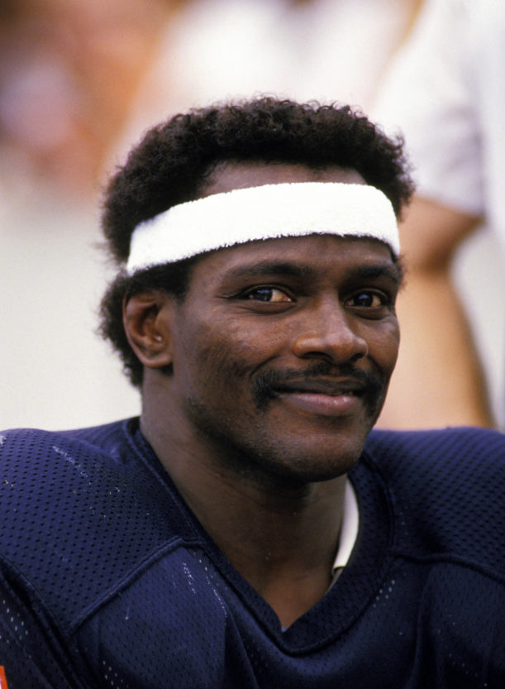
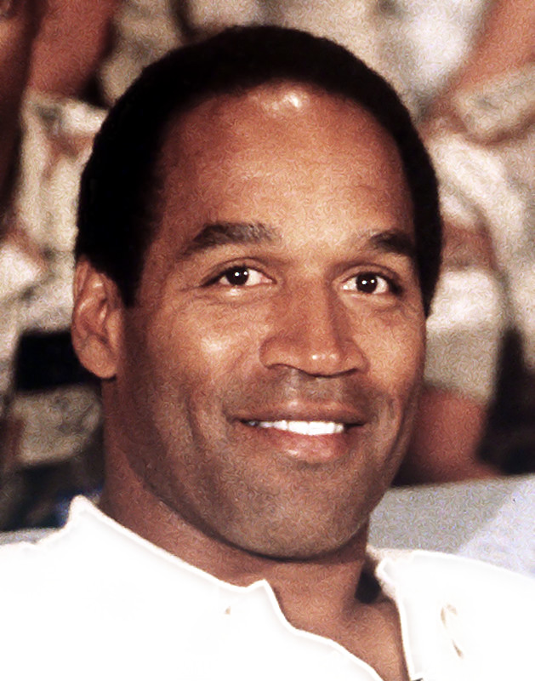
K-Nearest Neighbors
Pro
Con (Ex)

Slide 272
K-Nearest Neighbors
Pro
Con (Ex)
Works with small N
Works for non-binary cases
Can be run without training
Doesn’t give much of a description of results beyond “similar to A, B, C…”
Has trouble with features at differing scales

Slide 273
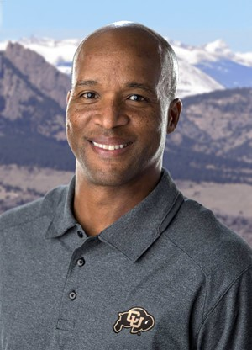

Naïve Bayes
Pro
Con

Slide 274
Naïve Bayes
Pro
Con
Works for non-binary cases
Can be run without training
Hard to implement for non-categorical data (without binning)

Slide 275
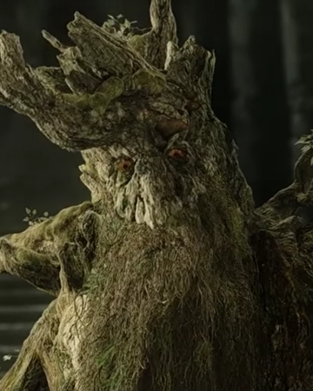
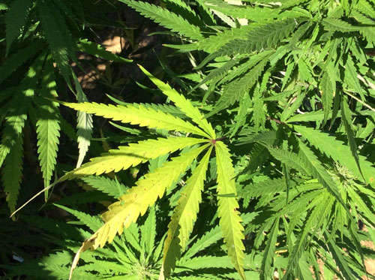
Decision Tree
Pro
Con (Ex)

Slide 276
Decision Tree
Pro
Con (Ex)
Easy to implement
Easy to follow
Easy(ish) to interpret
Prone to overfitting

Slide 277


Decision Forest / Adaboost
Pro
Con

Slide 278
Decision Forest / Adaboost
Pro
Con (Ex)
Adaptive to difficult-to-classify cases
Difficult to interpret

Slide 279
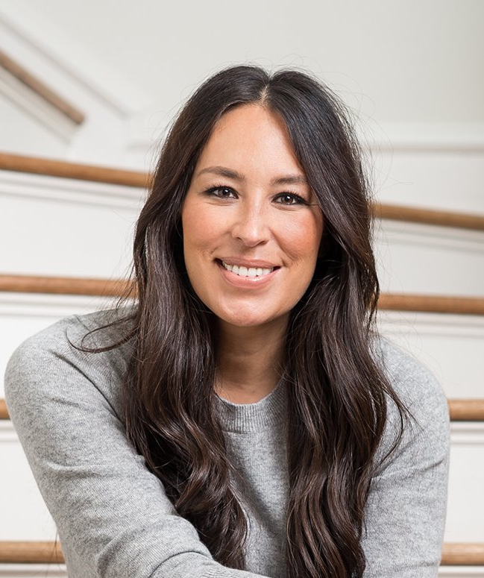

Logistic Regression
Pro
Con (Ex)

Slide 280
Logistic Regression
Pro
Con (Ex)
Linear decision boundary
Binary only

Slide 281


Support Vector Machines
Pro
Con

Slide 282
Support Vector Machines
Pro
Con (Ex)
Linear decision boundary
Binary only

